Slide 1
WMS Basic operating manual
Next-Gen AI Native Application

Slide 2

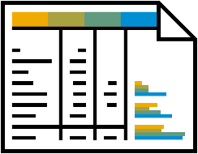







Overview
System initialize
1
Company Organization
Warehouse organization
User/Permission
2
material
customer
supplier
3
warehouse
Warehouse area
Warehouse location
4
Coding Rules
Business rules
Business and mobile type
Label Management
Organizational Setting
basic data
warehouse
Rules Setting
Org Management
Role List
Warehouse Information
Coding Rules
Customer Classification List
Shelving Rules
Customer Information
User List
Warehouse Area Management
Inventory Turnover Rues
Supplier Classification List
Factory Information
Order Picking Allocation Rules
Supplier Information
Location Management
Over-receipt Rules
Material Classification
Business Type
Unit of Measure
Inventory Organization List
Material Record

Slide 3
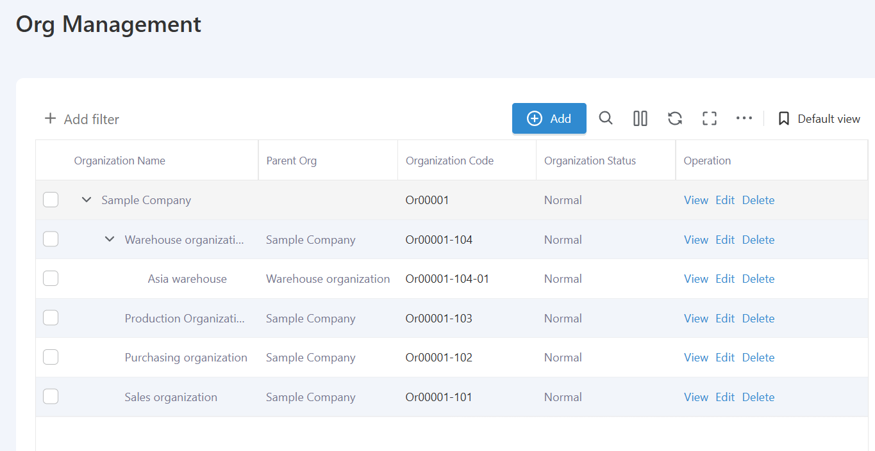
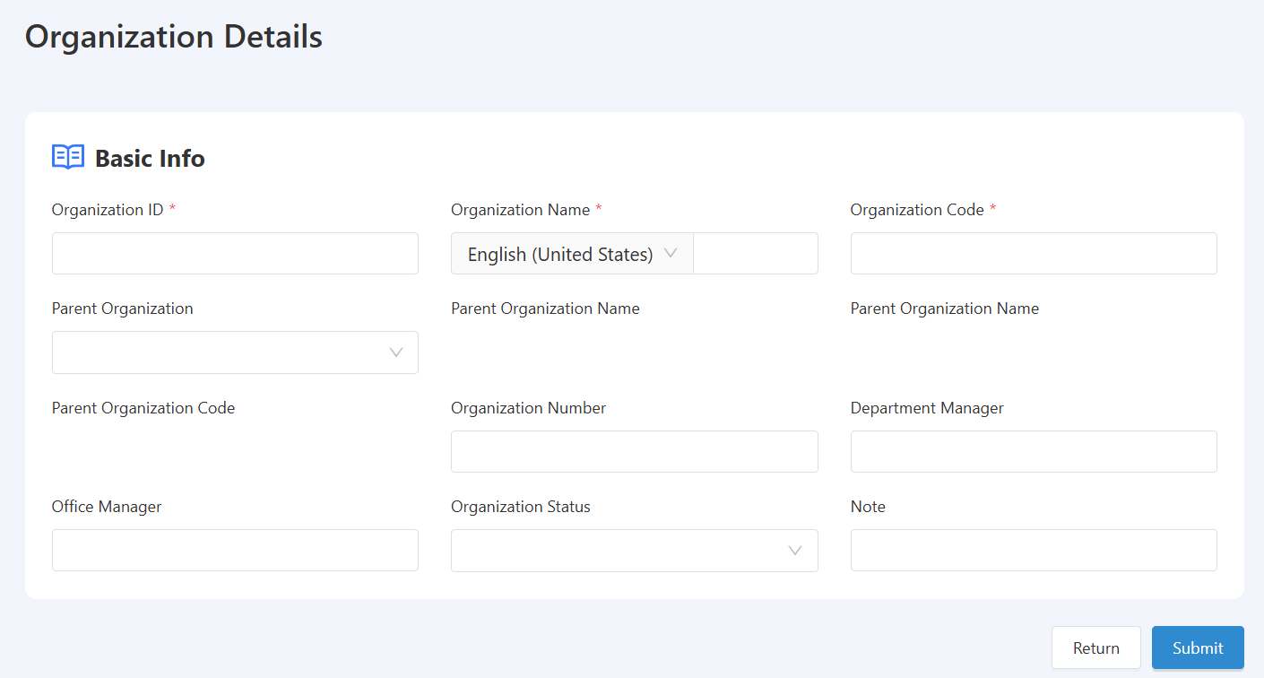
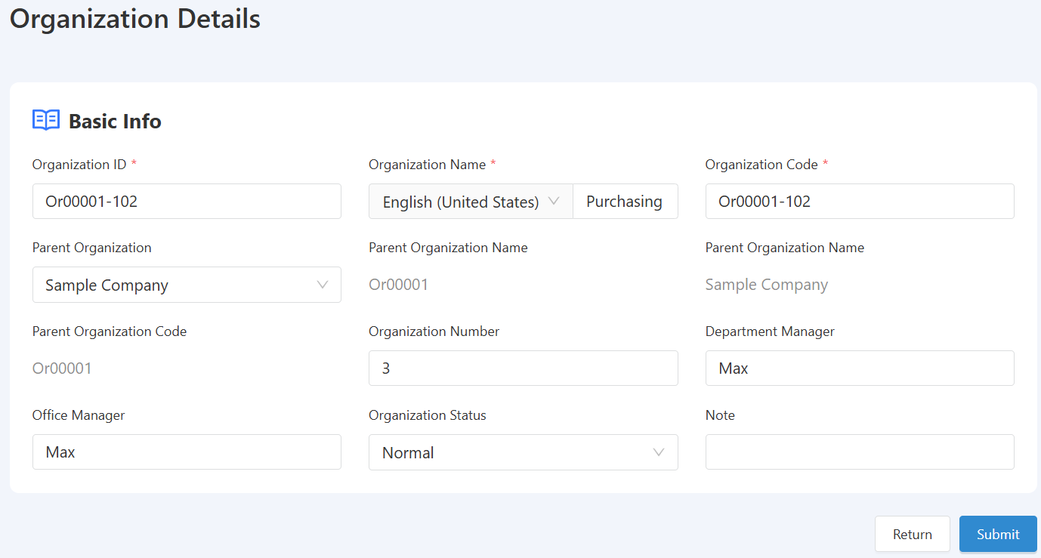
WMS Basic initialization-Org Management
Description: Add/Edit/Delete Organization
Path: [System Management] -> [Organization Management]
Description: This section is used to manage the company's organizational structure, involving the management of subsequent permissions, data, and business documents of the company.

Slide 4
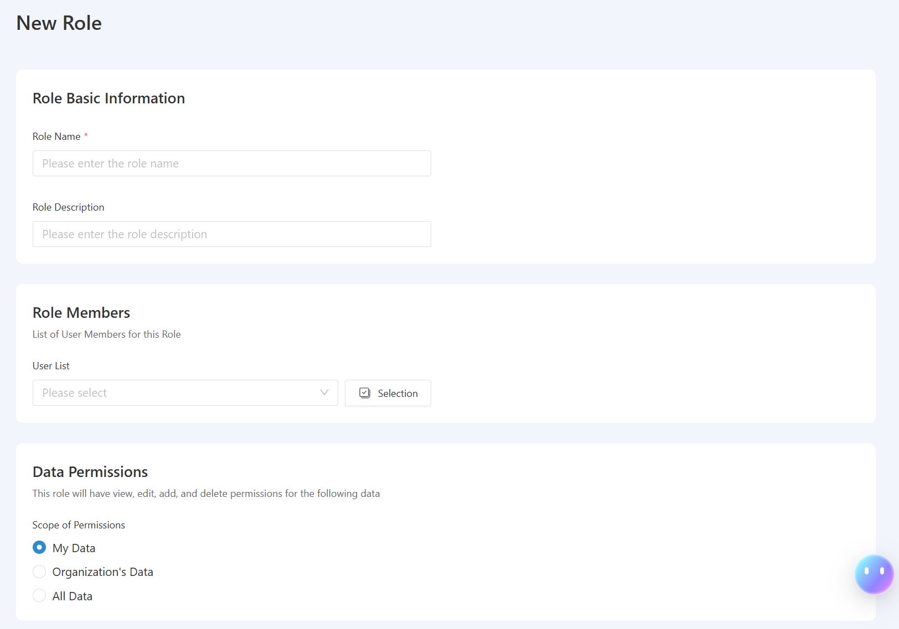
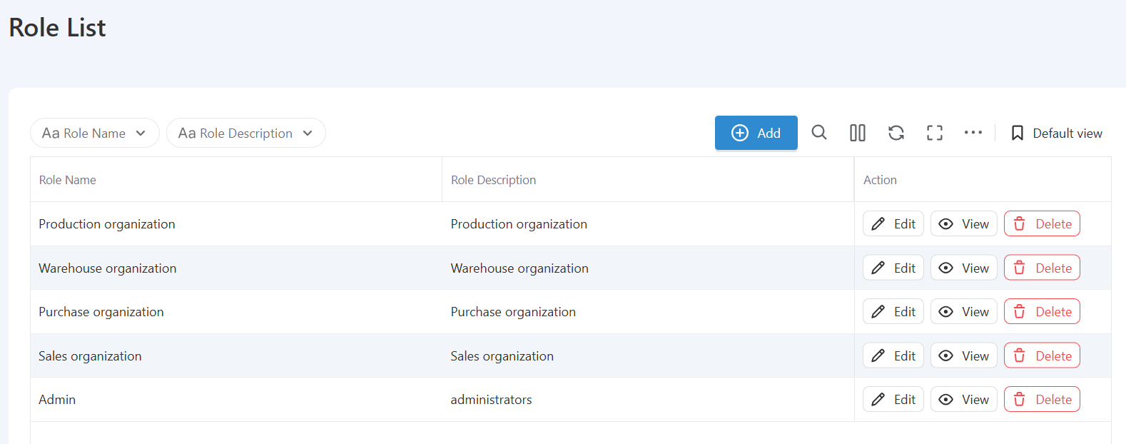
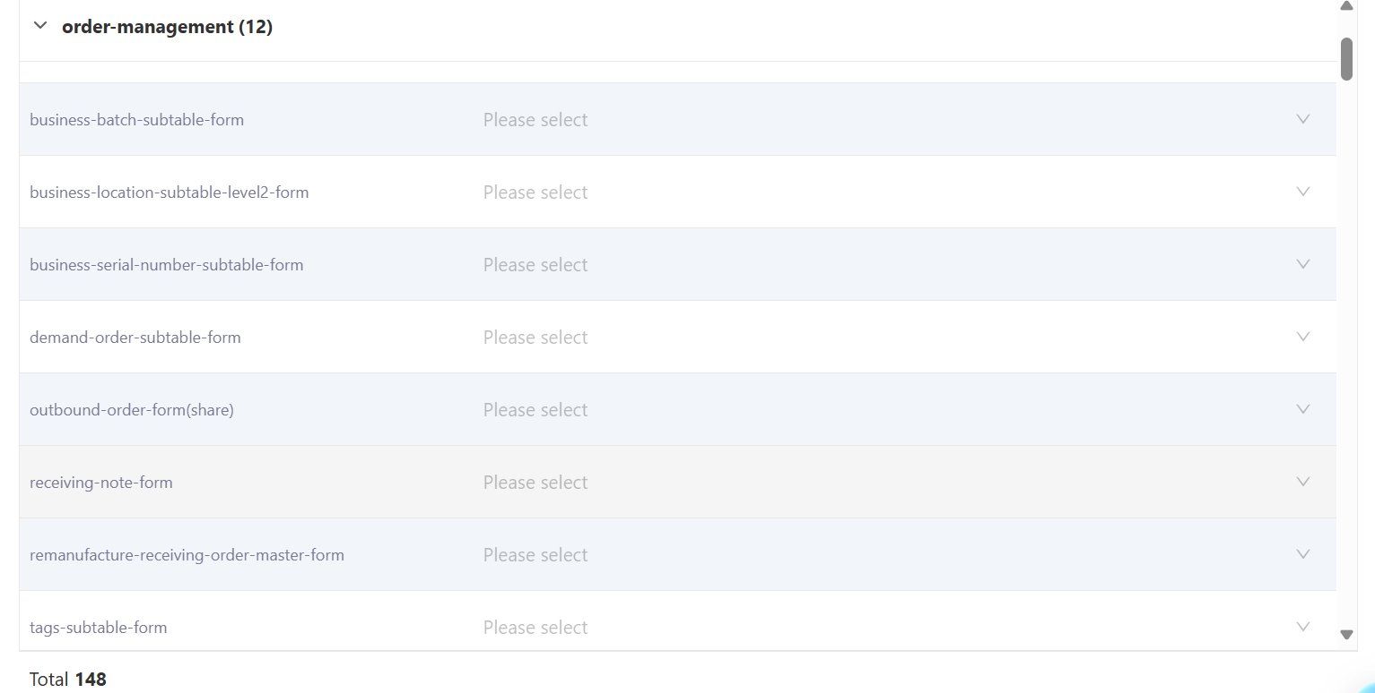
WMS Basic initialization - Role and permission management
Description: Add/Edit/Delete Roles
Path: [System Management] -> [Role List]
Description: This section is used to manage the roles and permissions of company WMS users. Only in the [Role List] can you maintain the corresponding roles of the company and the permissions [Data Permissions] & [Form Permissions] of these roles.
After completing the above settings, select the users included in the current role and bind them to grant relevant permissions to the users.

Slide 5
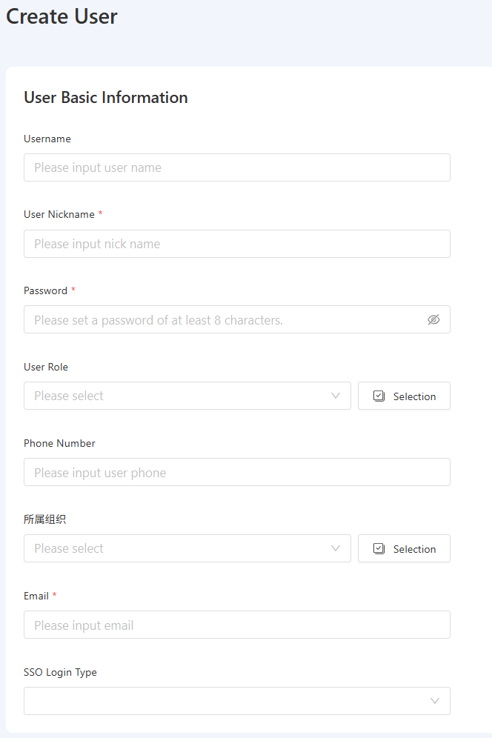
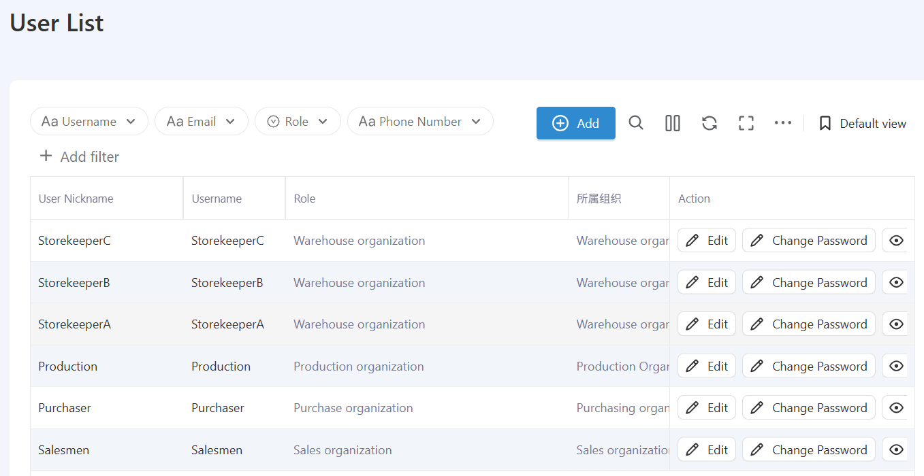
WMS Basic initialization-Org Management
Description: Add/Edit/Delete Users
Path: [System Management] -> [User Management]
Description: This section is used to manage the login accounts for the company's WMS system. Only by adding new user information in [User Management] can users log into the system. [Edit User Permissions] Initial password: Wms-basic
Fields marked with "*" are required

Slide 6
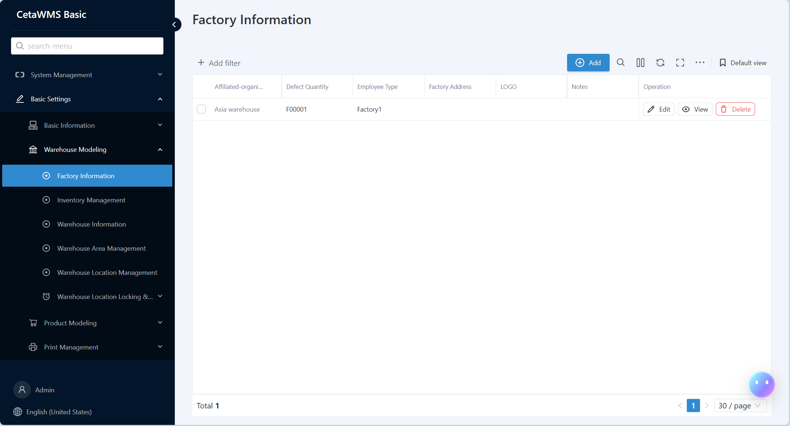
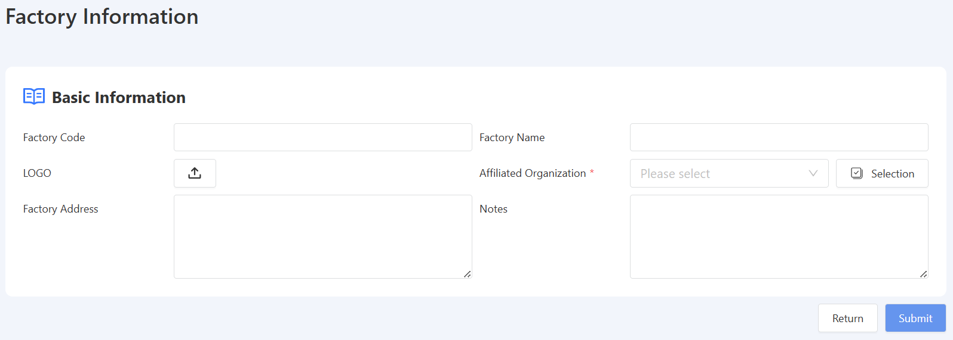
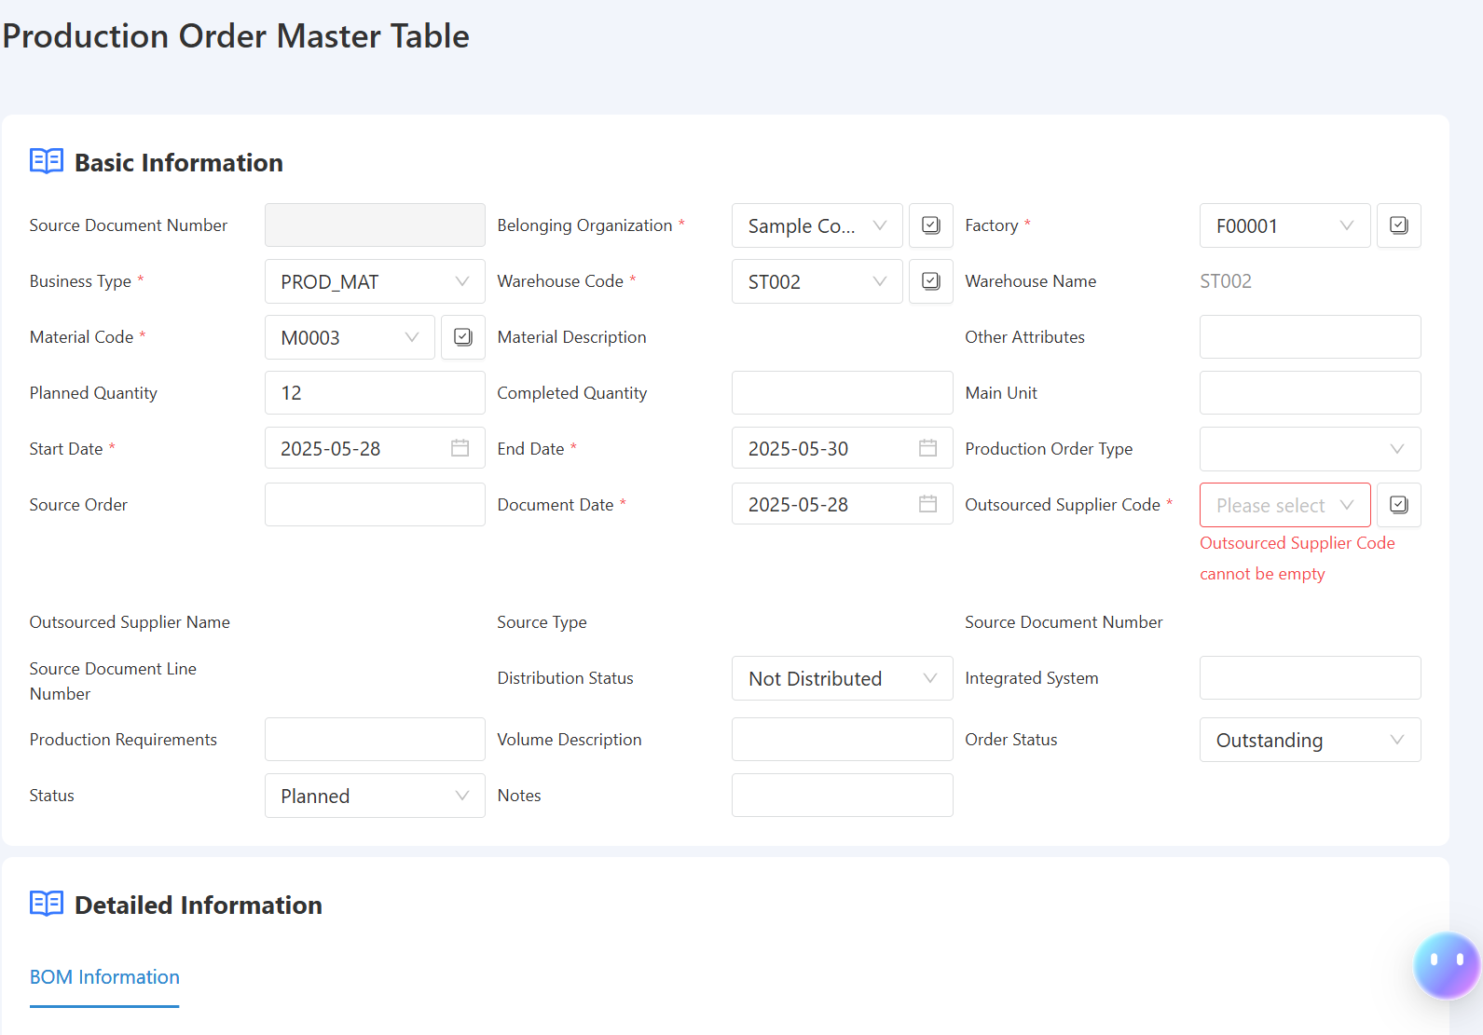
WMS Basic initialization-Factory Information
Description: Add/Edit/Delete Factory
Path: [Basic Settings] -> [Warehouse Modeling] -> [Factory Information]
Description: This section is used to maintain the information of the factories to which the company's organization belongs in actual business operations.
When your company has production operations, it is necessary to clarify the factory attributes. You can maintain factory information here and associate it with the [Production Order].

Slide 7
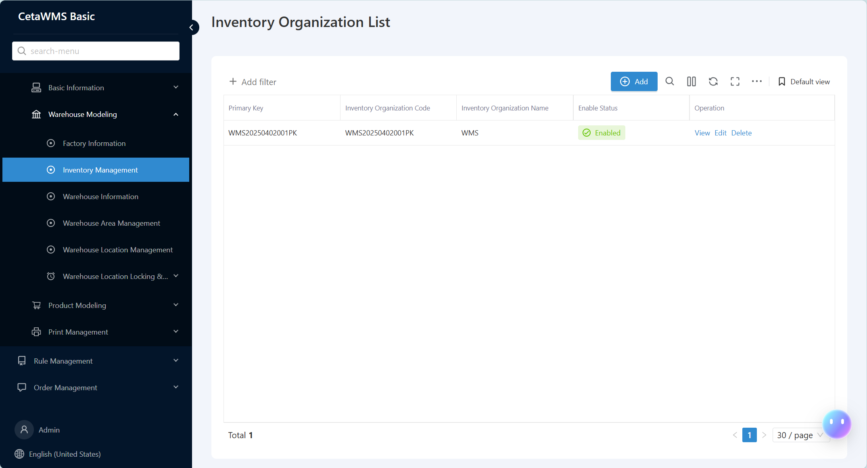
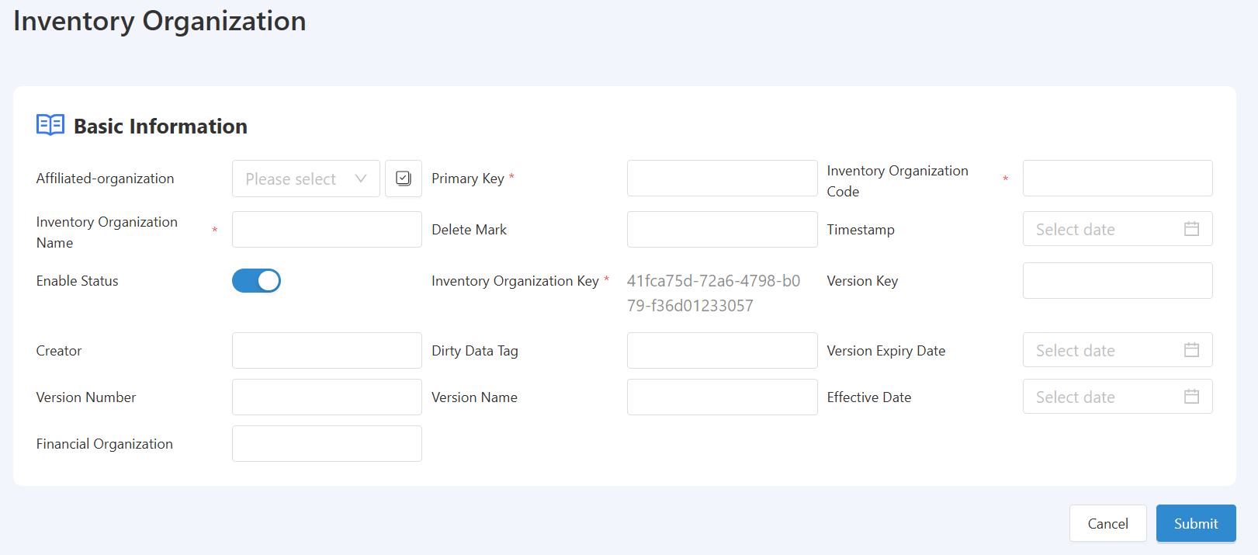
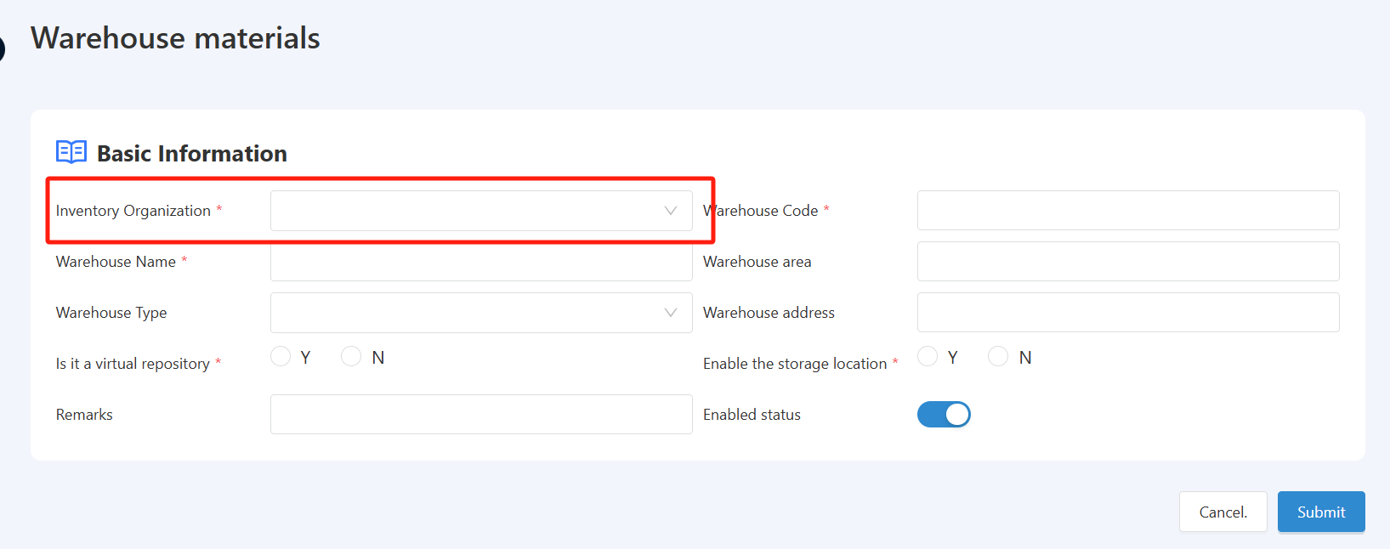
WMS Basic initialization-Inventory Organization List
Description: Add/Edit/Delete Warehouse Organizations
Path: [Basic Settings] -> [Warehouse Modeling] -> [Inventory Management]
Description: This section is used to maintain the warehouse organization in the company's actual business operations, and to manage different warehouse organizations within the company.
When your company has multiple warehouse organizations to manage across different locations or different types of warehouses supporting various businesses, you can establish classification and grouping management through this feature.

Slide 8
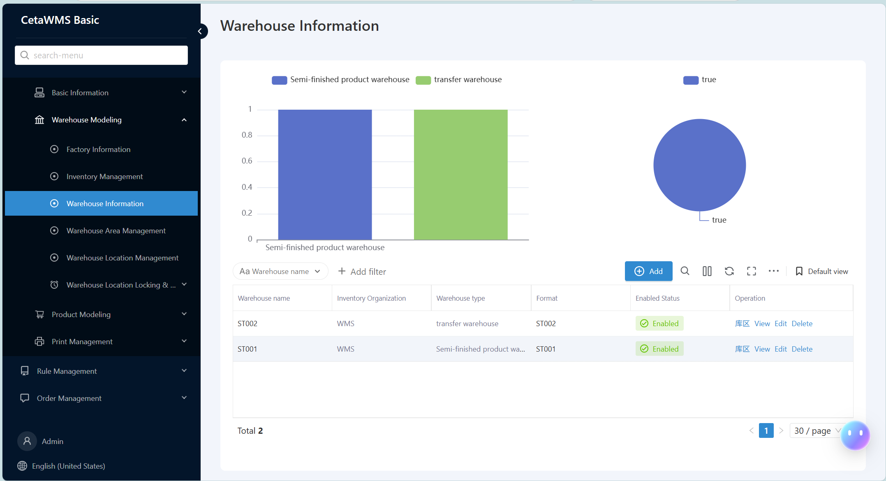
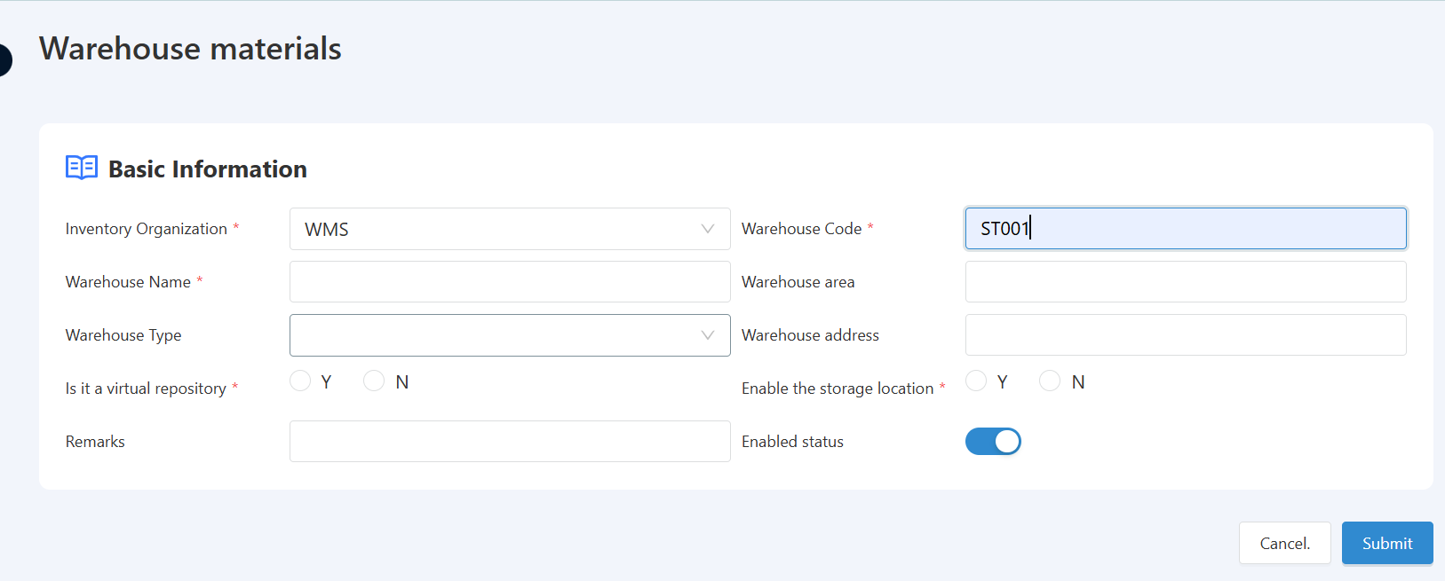
WMS Basic initialization-Warehouse Information
Description: Add/Edit/Delete Warehouse
Path: [Basic Settings] -> [Warehouse Modeling] -> [Warehouse Information]
Description: This section is used to maintain warehouse information in the company's business management. The warehouse code here is a unique value.
Note that when establishing a warehouse here, it is necessary to add or modify the corresponding warehouse according to actual business needs. The warehouse can be either a physical or virtual one, and it is used to manage the ownership of materials in the current warehouse. The system manages and compiles warehouse data based on the warehouse.

Slide 9
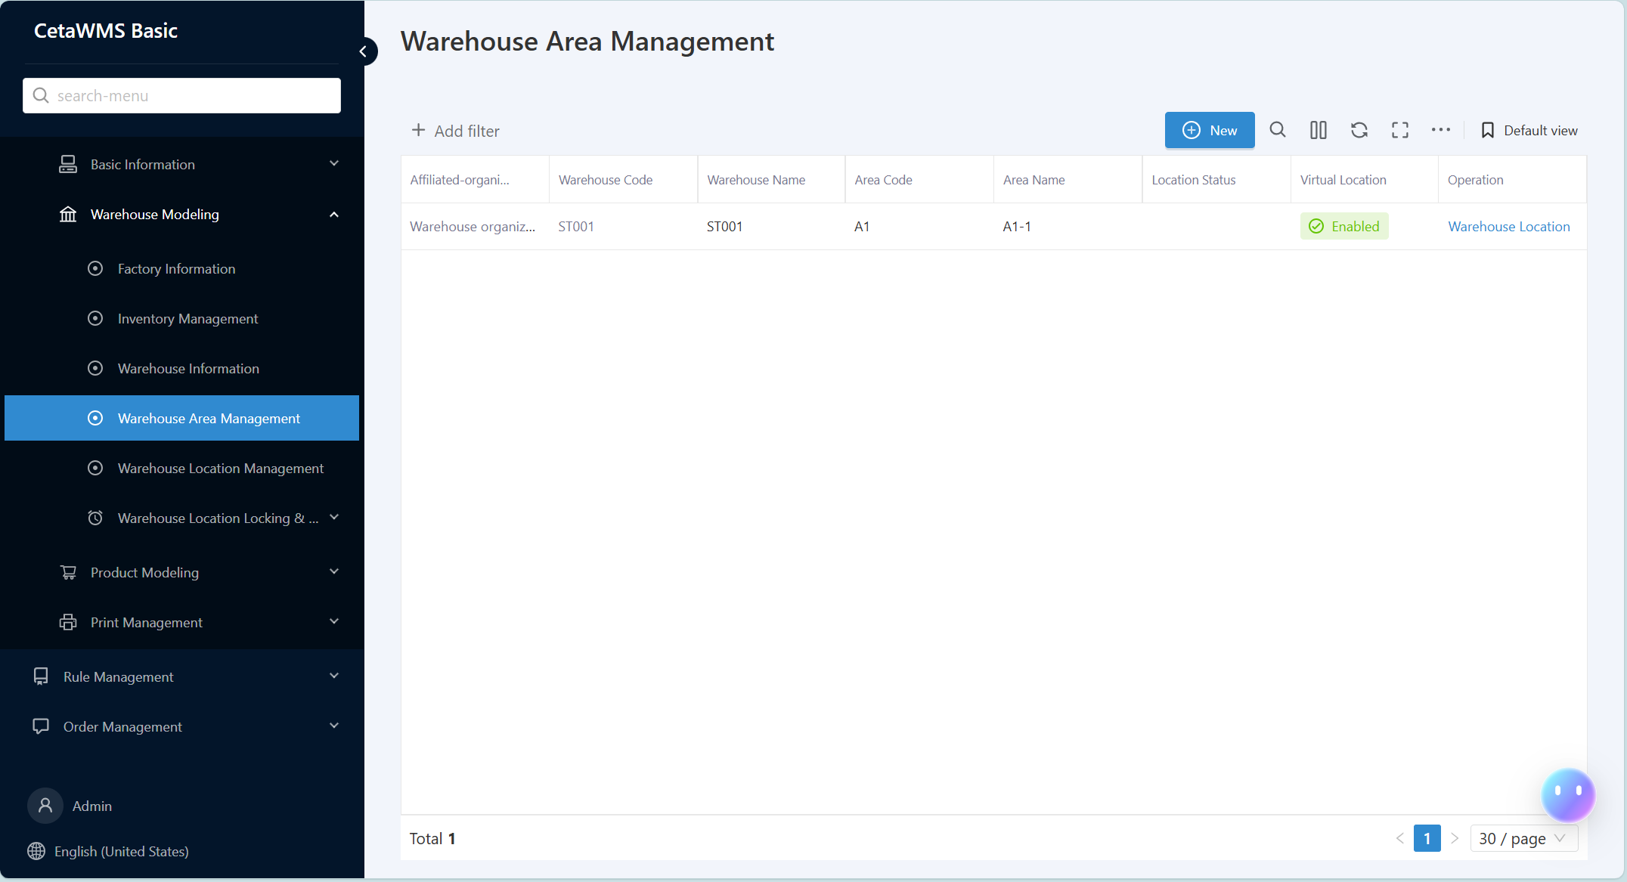
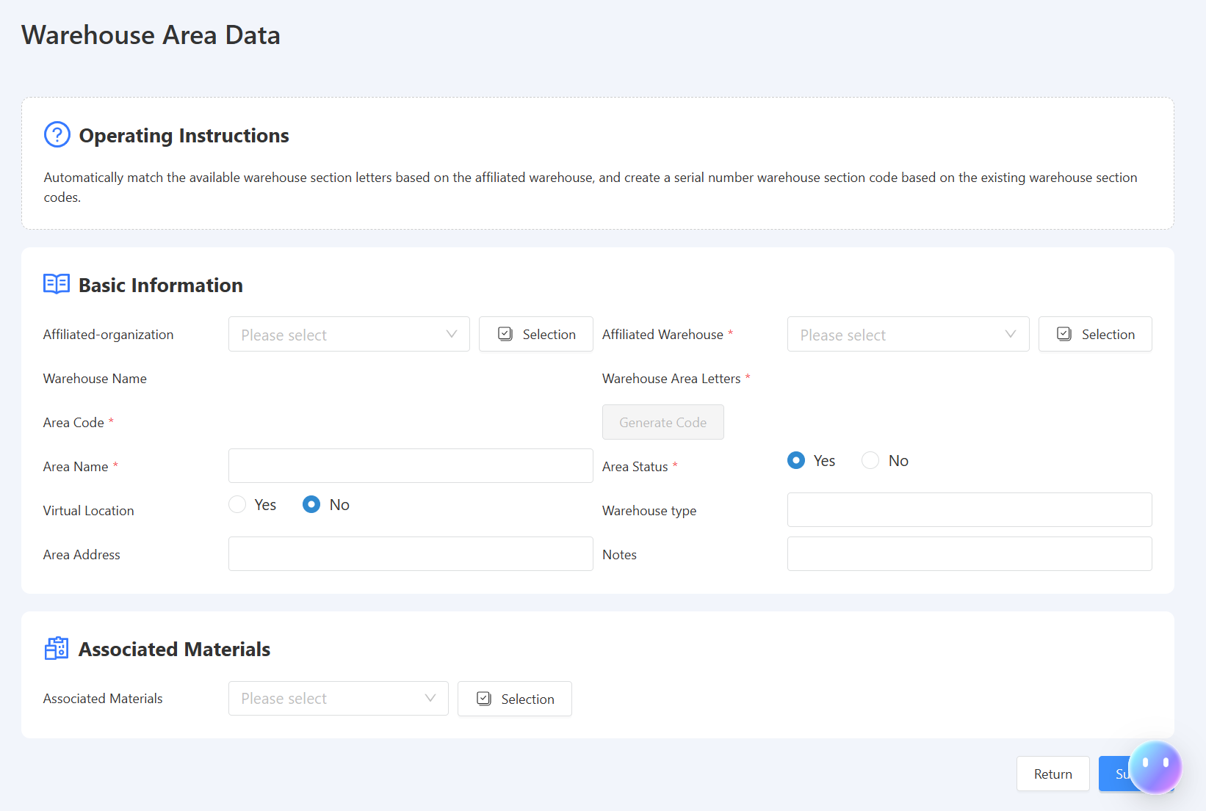
WMS Basic initialization-Warehouse Area Management
Description: Add/Edit/Delete Warehouse Area
Path: [Basic Settings] -> [Warehouse Modeling] -> [Warehouse Area Management]
Description: This section is used to maintain the subordinate warehouse areas within the company's business management, applicable to situations where a single warehouse is managed across multiple areas.
In common business operations, a warehouse may have different management zones under it, facilitating division and management, and allowing for the classified storage of different materials or materials with different packaging management forms.

Slide 10
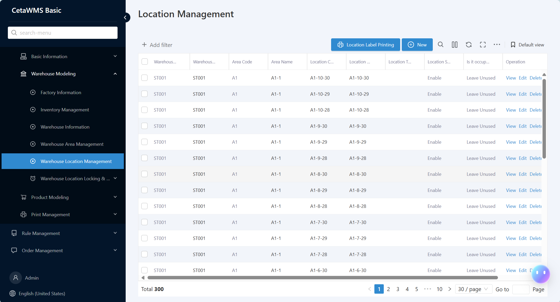
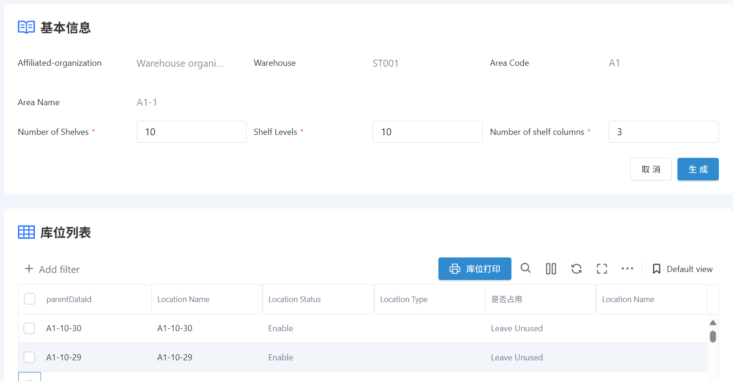
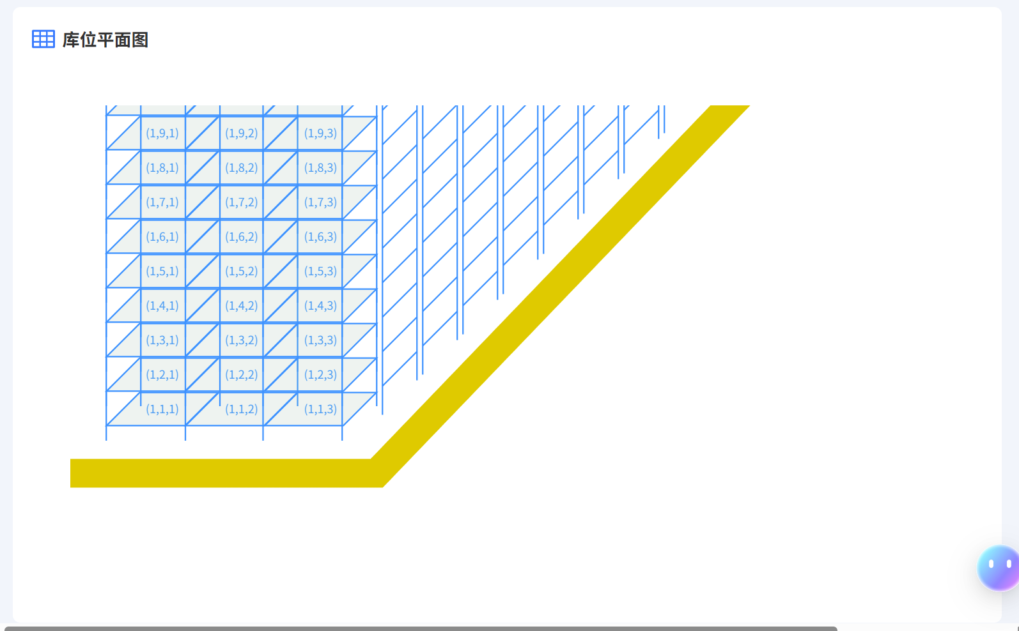
WMS Basic initialization-Warehouse Location Management
Description: Add/Edit/Delete storage locations
Path: [Basic Settings] -> [Warehouse Modeling] -> [Warehouse Location Management]
Description: This section is used to maintain information about different warehouse locations within the subordinate warehouse areas of the company's business management.
This section defines the specific locations of warehouses and their corresponding material relationships within the enterprise, enabling refined management. It facilitates on-site operators to quickly locate material positions, thereby enhancing operational efficiency and accuracy.

Slide 11
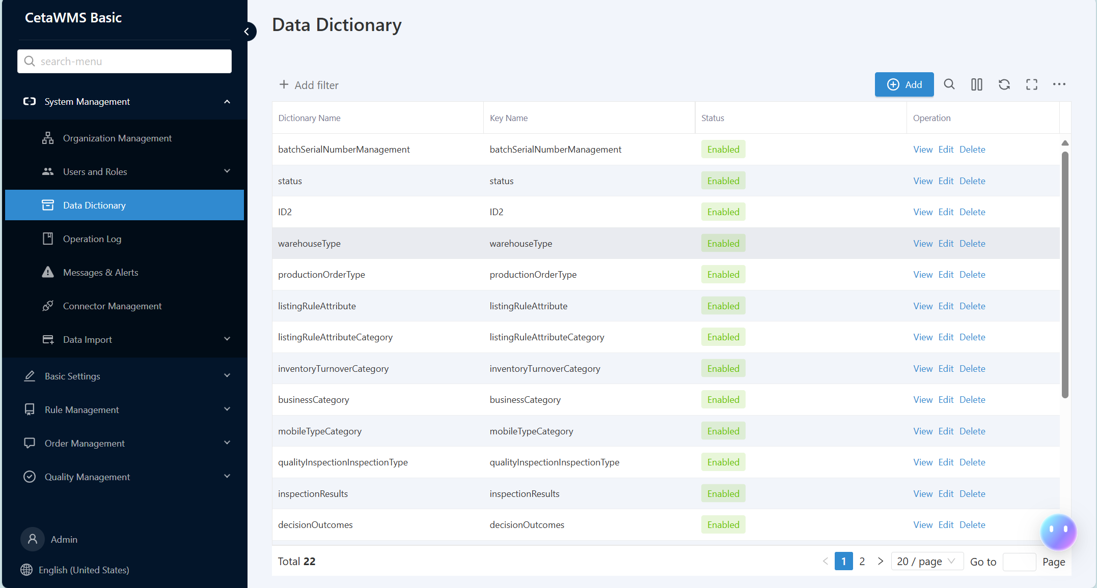
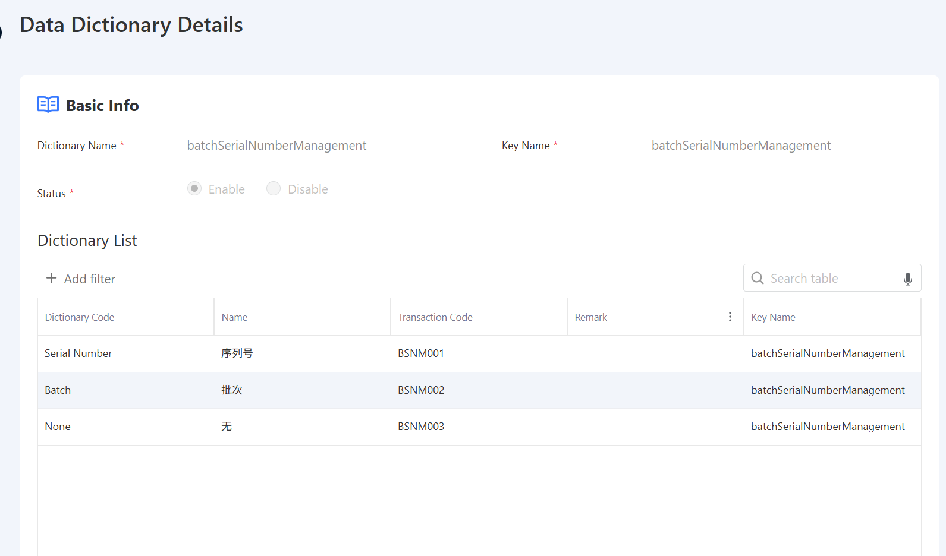
WMS Basic initialization-Data Dictionary
Description: Add/Edit/Delete Dictionary
Path: [System Management] -> [Data Dictionary]
Description: This section is used to maintain the values in the drop-down options in the system.
The transaction code in this section is a system business judgment value and cannot be duplicated.

Slide 12
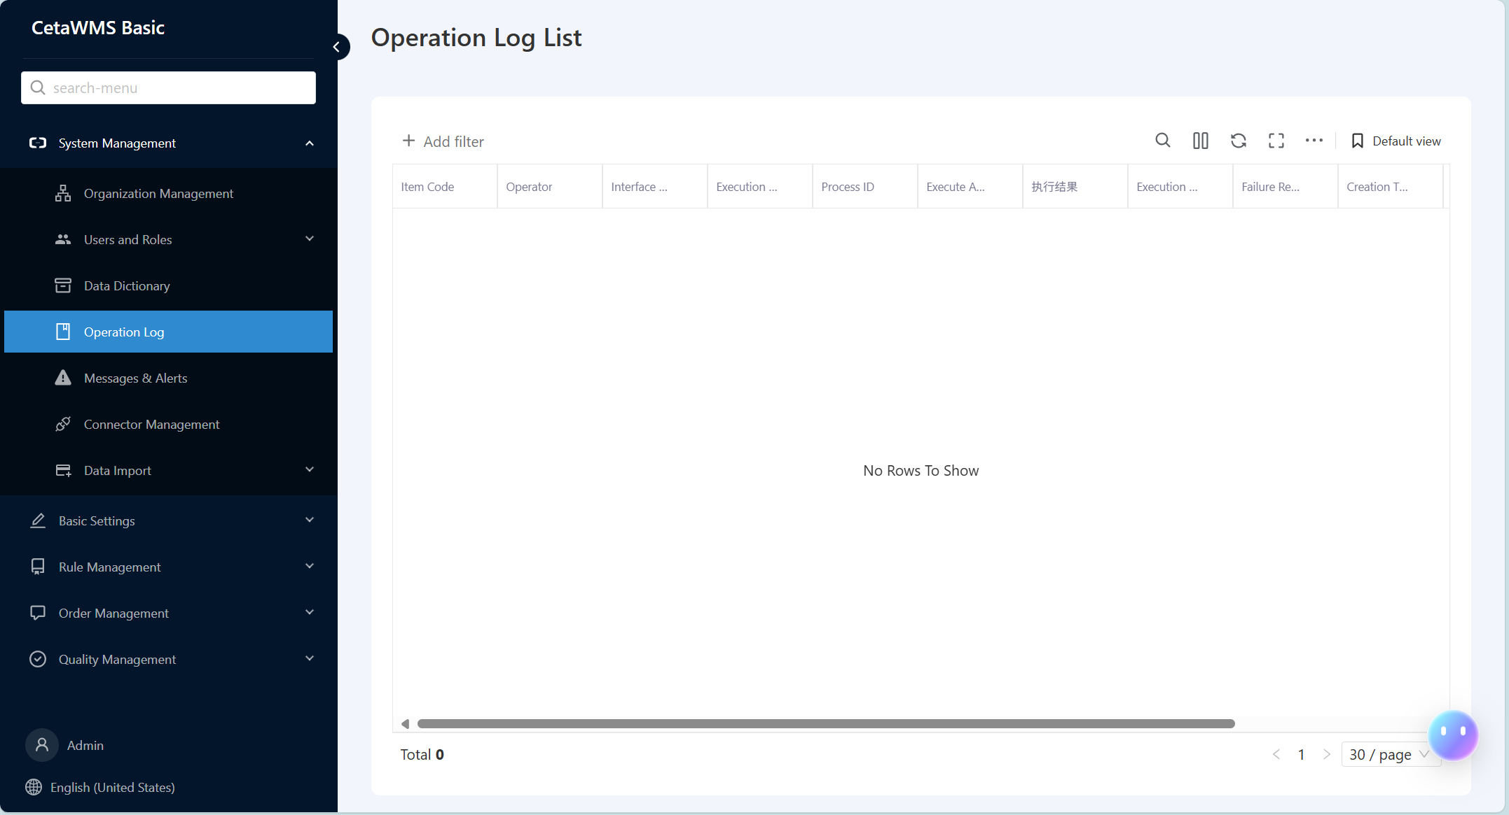
WMS Basic initialization-Operation Log
Description: Add/Edit/Delete Dictionary
Path: [System Management] -> [Operation Log]
Description: This section is used to record system business operation logs.

Slide 13
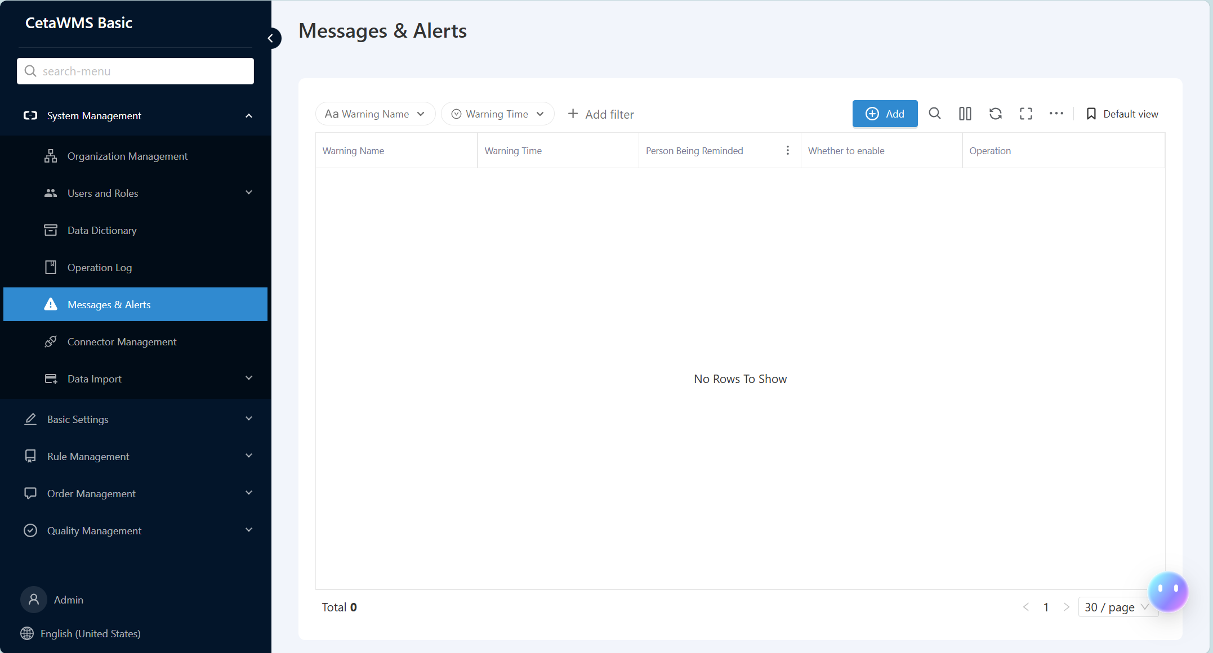
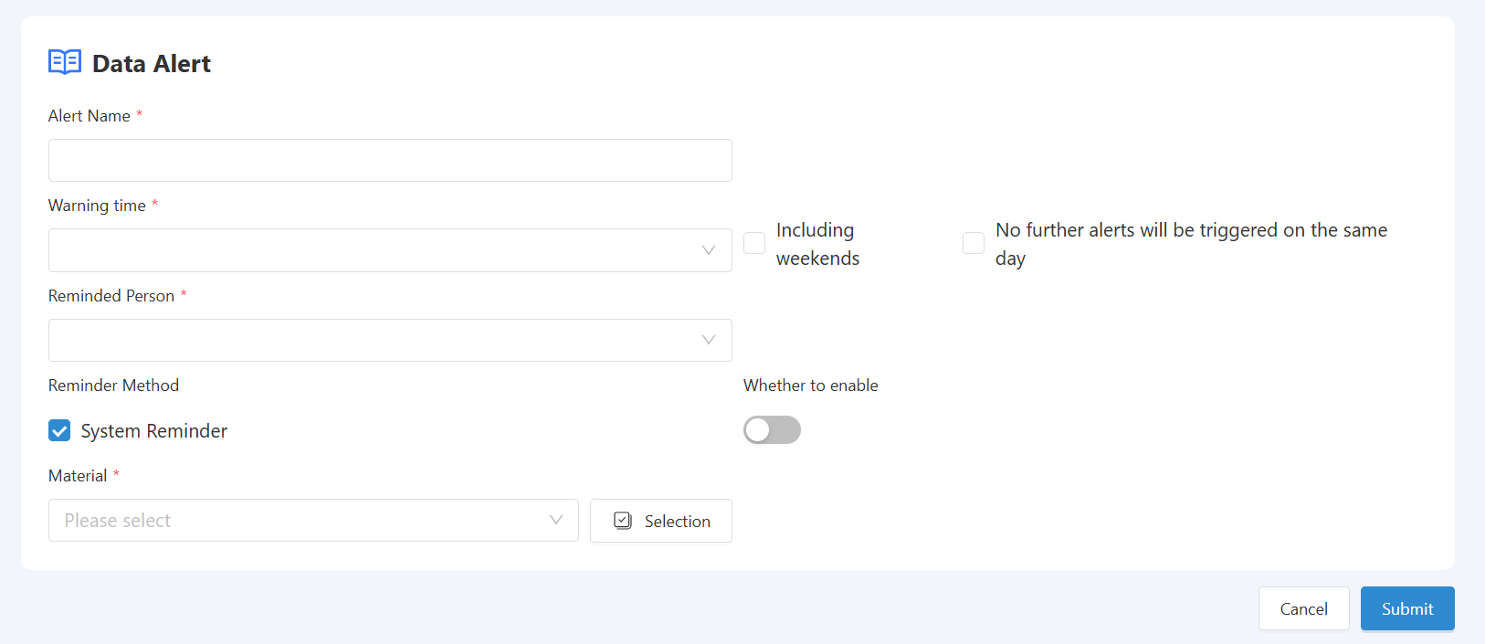
WMS Basic initialization-Messages & Alerts
Description: Add/Edit/Delete Alerts
Path: [System Management] -> [Messages & Alerts]
Description: This section is used to maintain the system's inventory warning information.
Based on the information maintained for inventory pre-warning, the system conducts data monitoring for reminders.

Slide 14
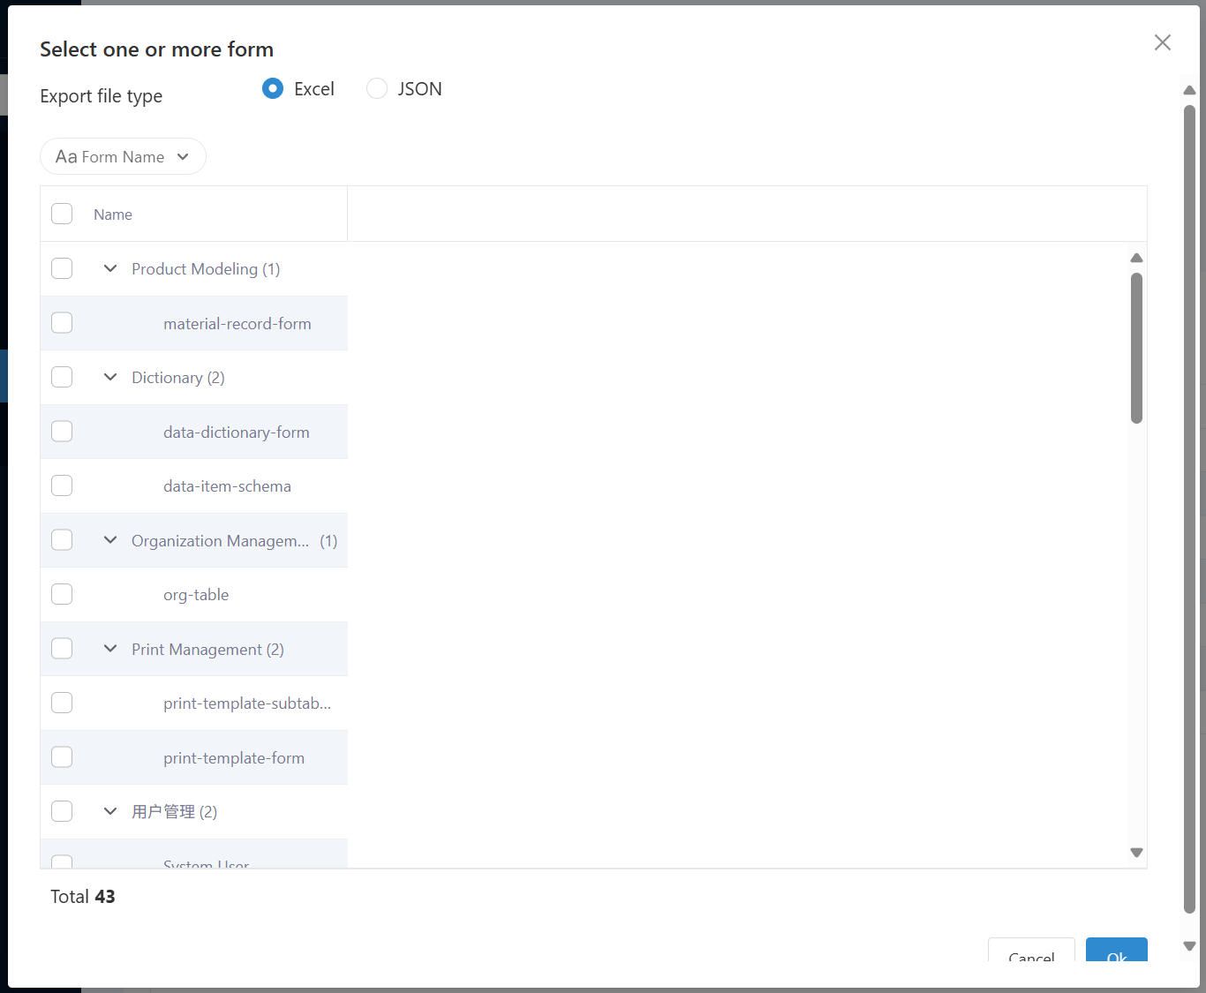
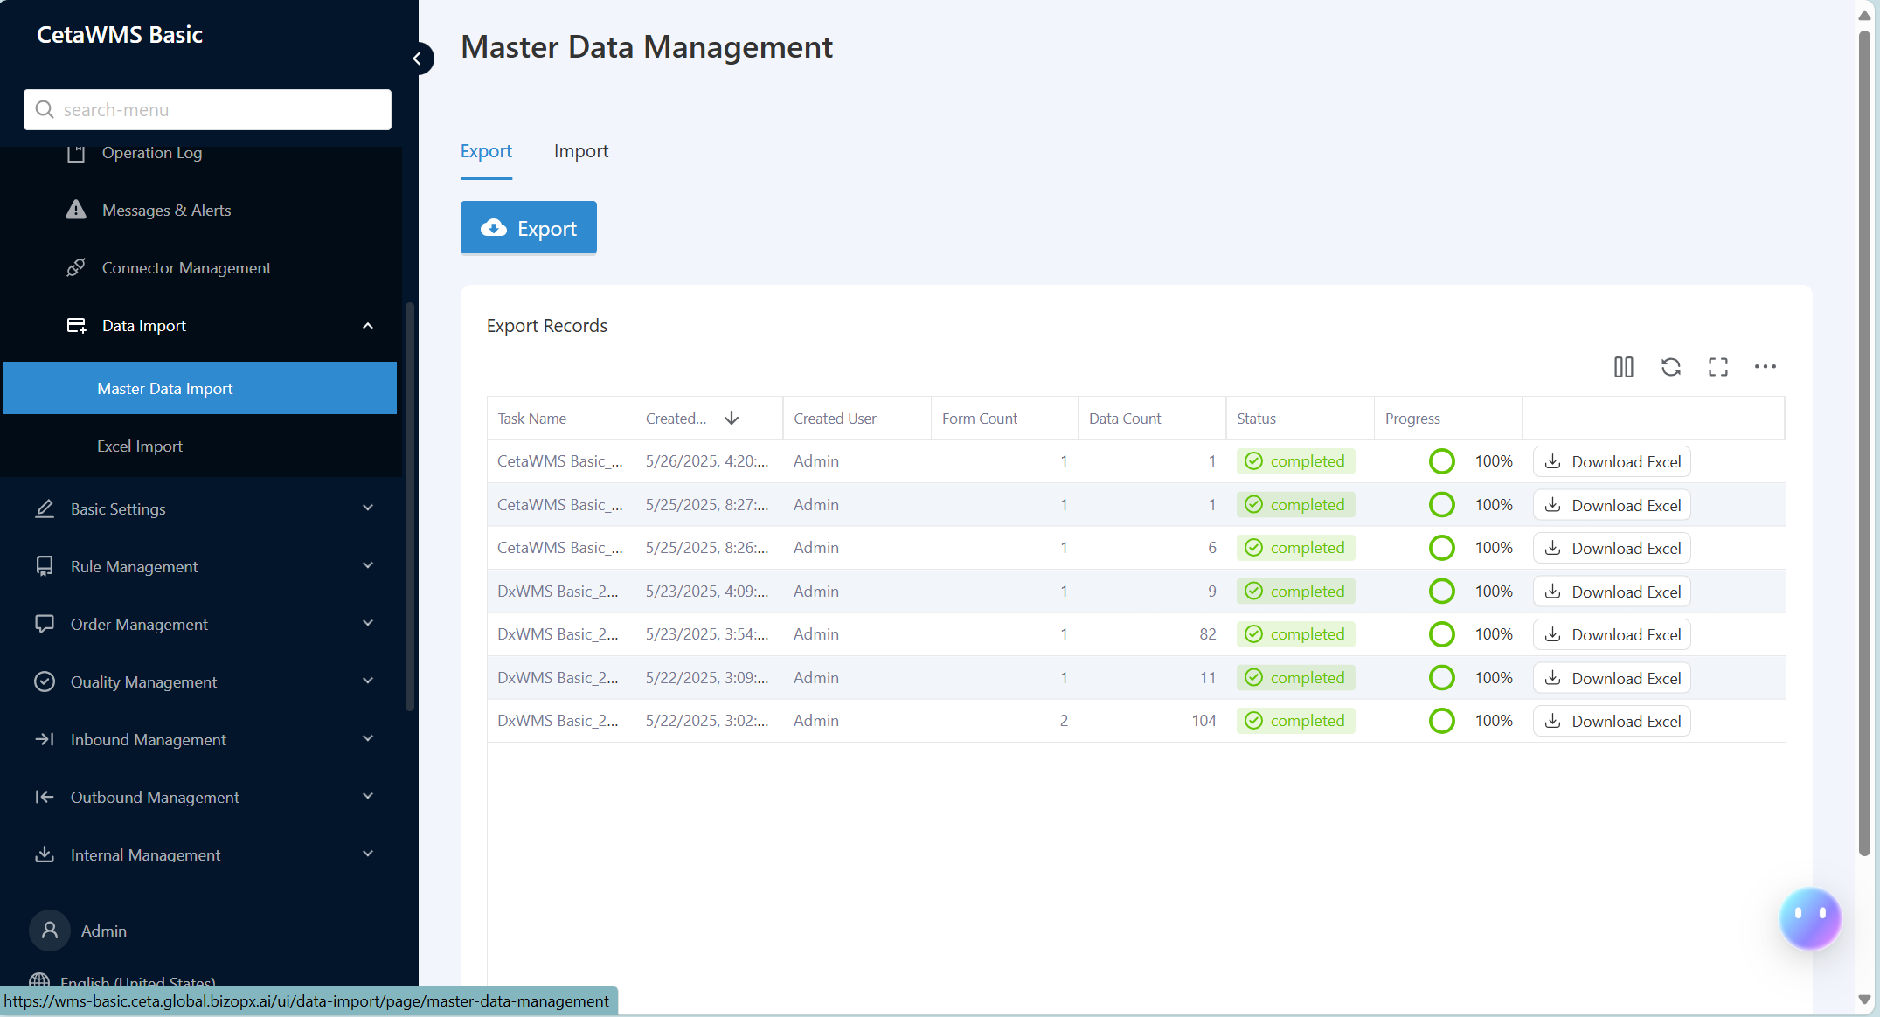
WMS Basic initialization-Master Data Management
Description: Add/Edit/Delete Alerts
Path: [System Management] -> [Master Data Import]
Description: This section is used for batch importing system data during system initialization.
The system provides a data import template. Users can fill in relevant batch data based on the selected export template and then import it into the system.

Slide 15
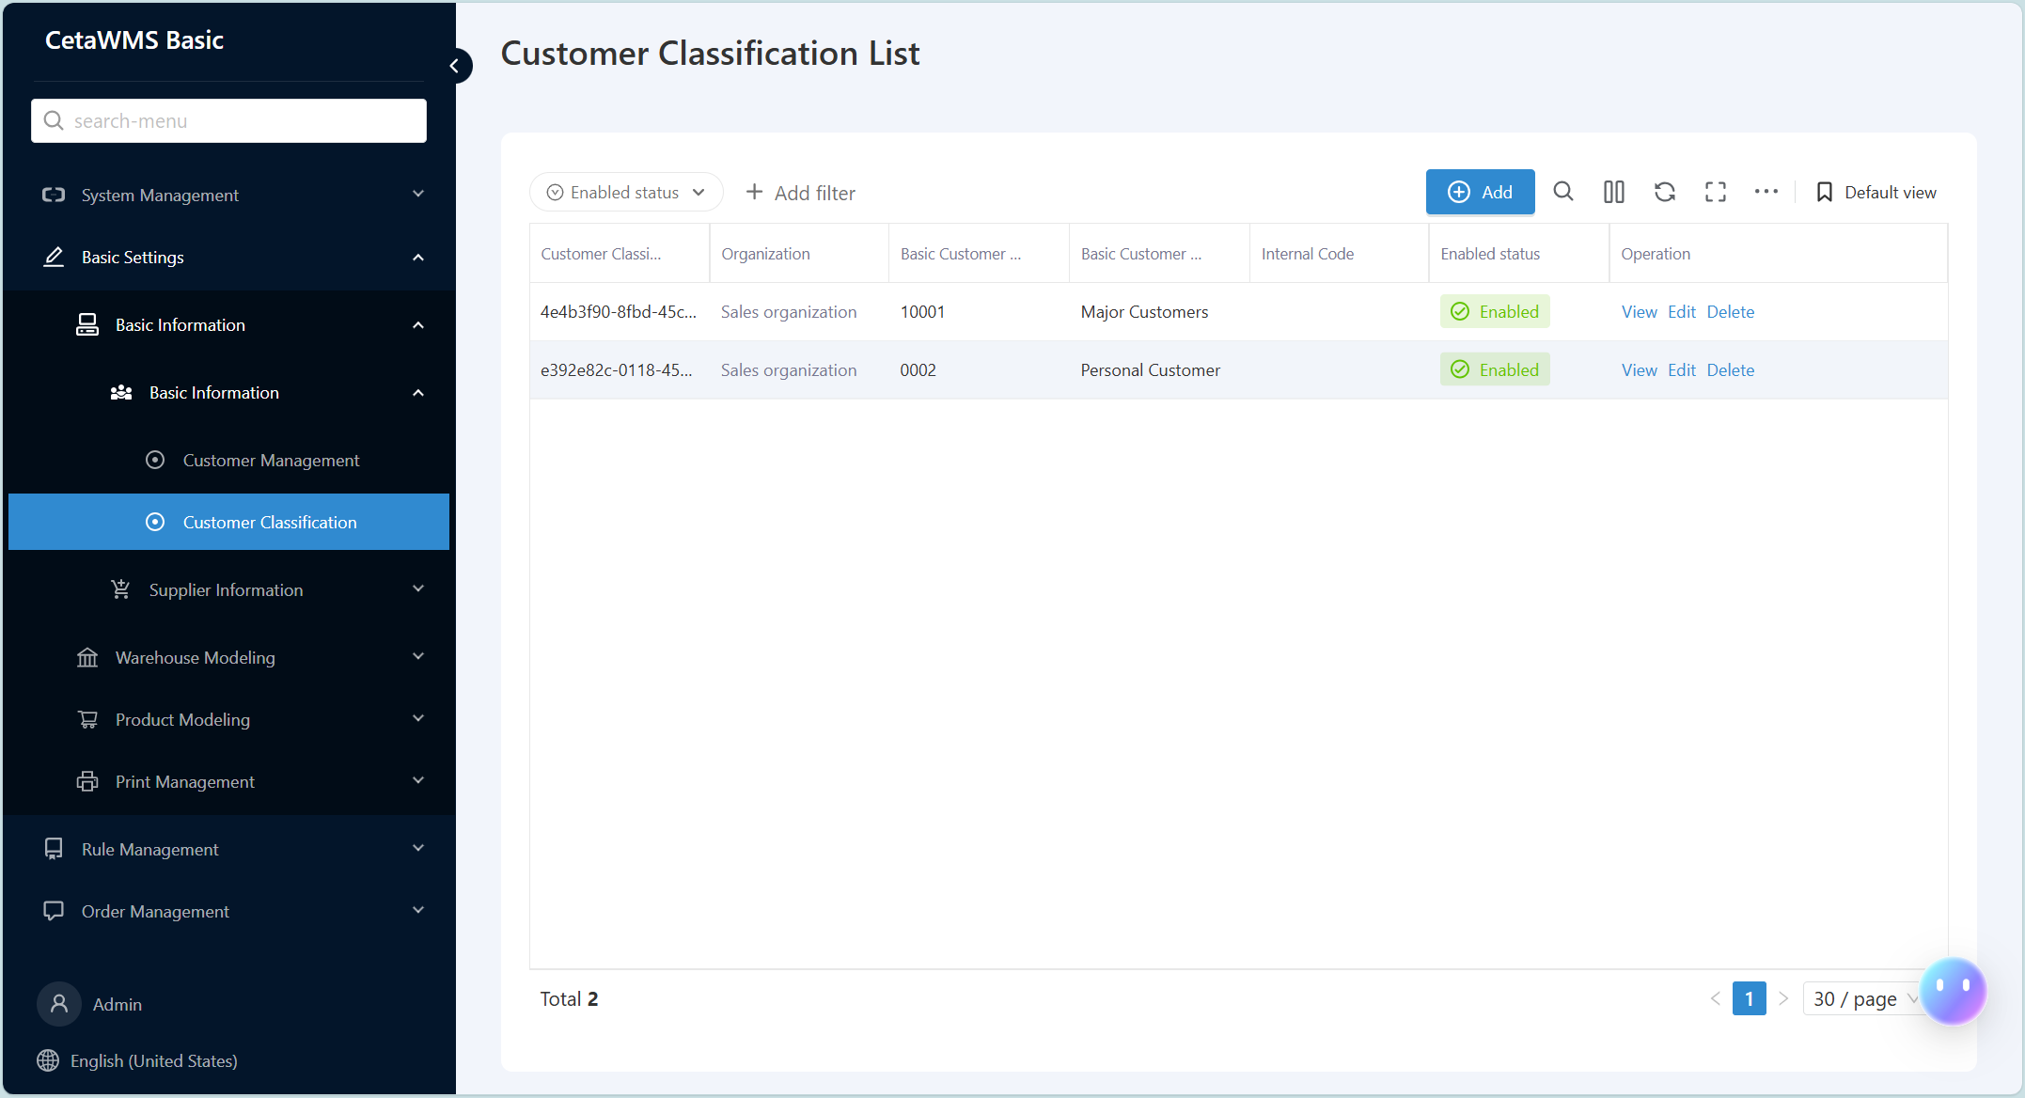
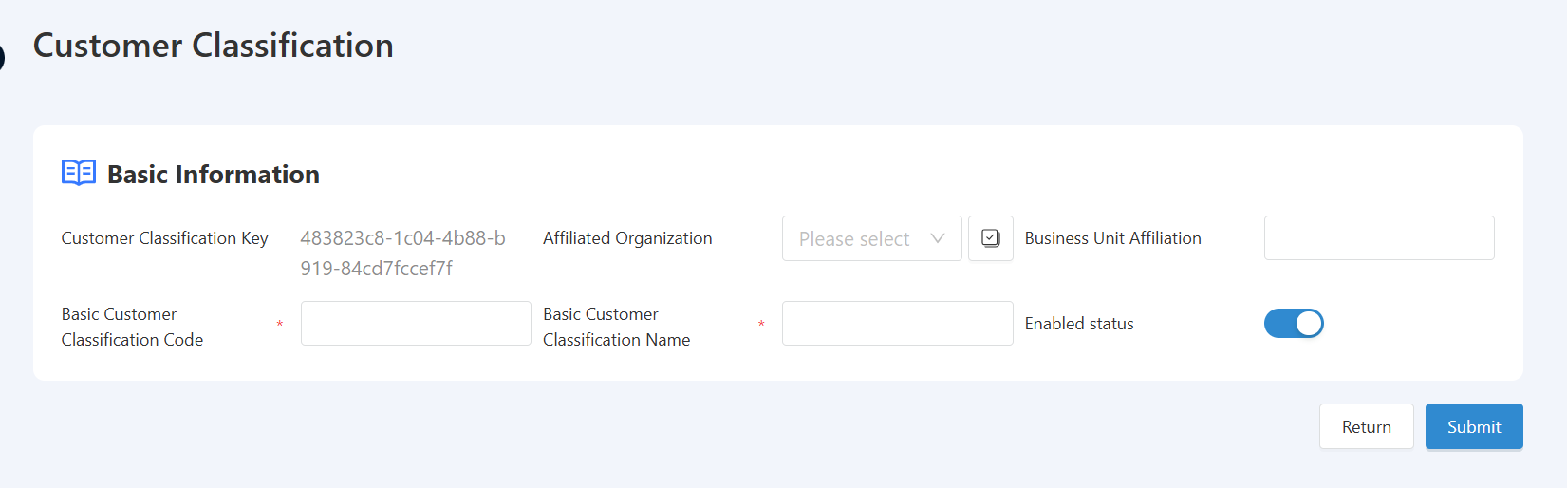
WMS Basic initialization-Customer Classification
Description: Add/Edit/Delete Customer Classification
Path: [Basic Settings] -> [Customer Classification]
Description: This section is used for maintaining the classification of enterprise customers.
Enterprises can maintain customer classification information in accordance with internal management requirements, and subsequently establish user customer profiles.

Slide 16
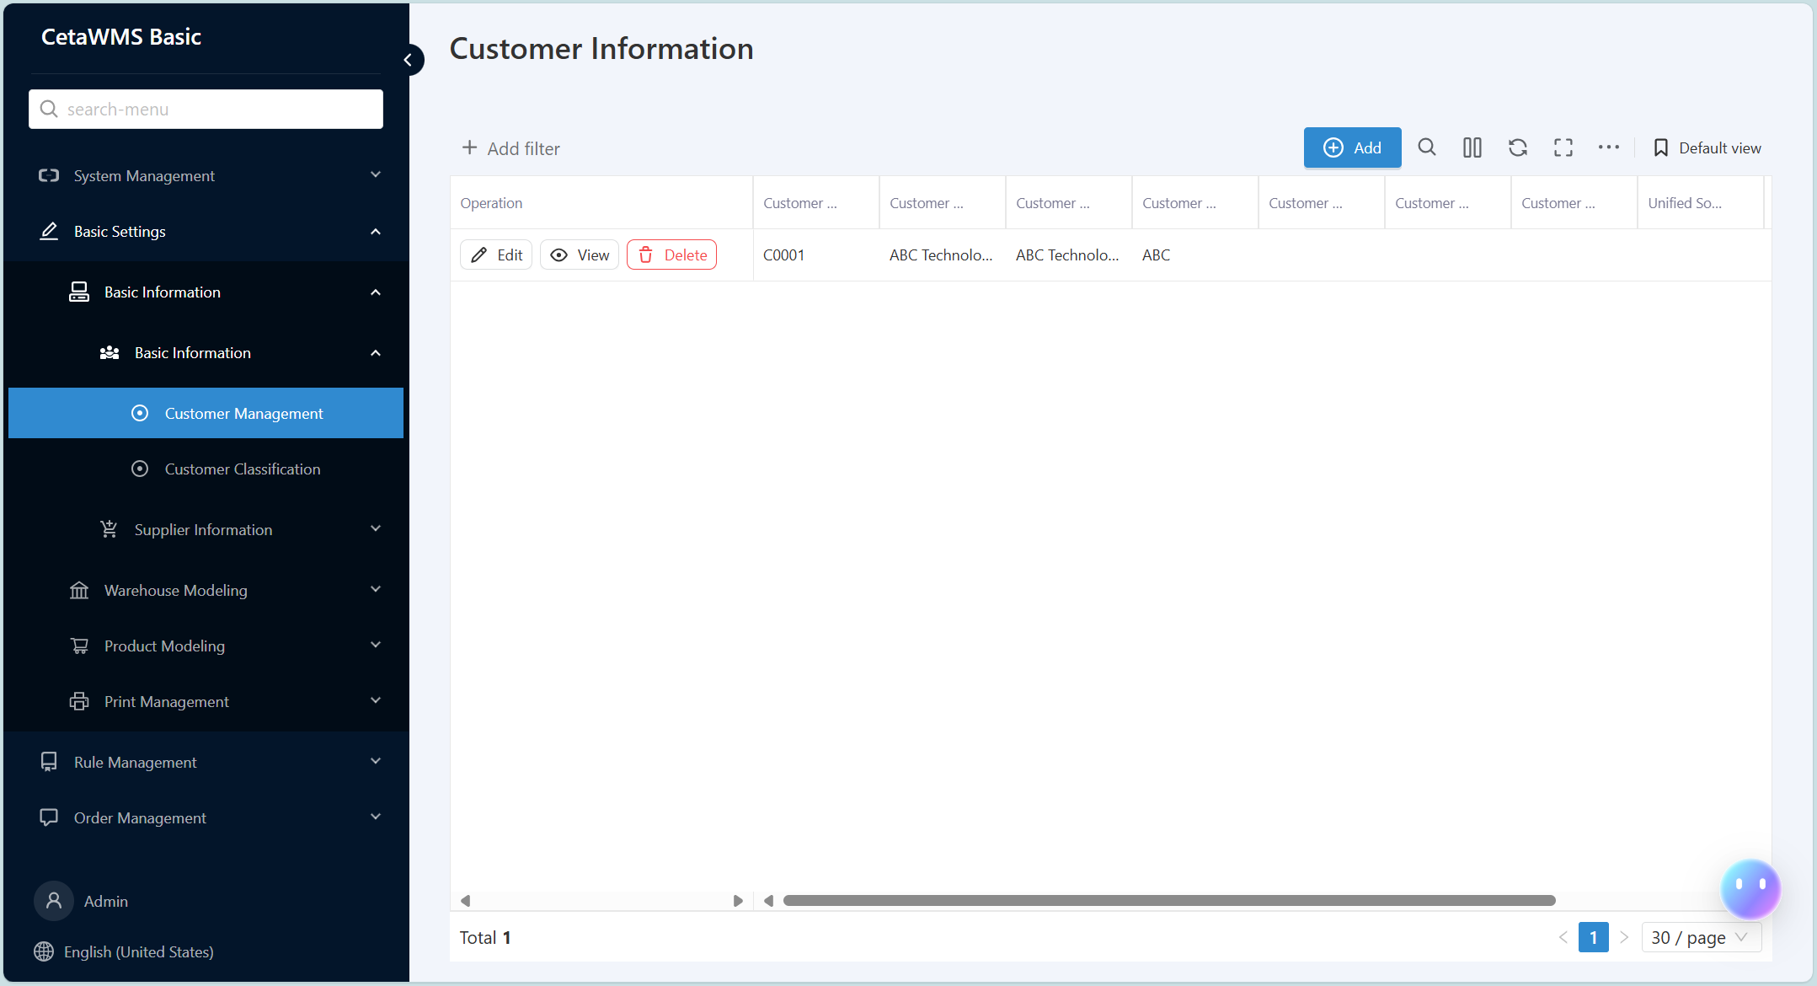
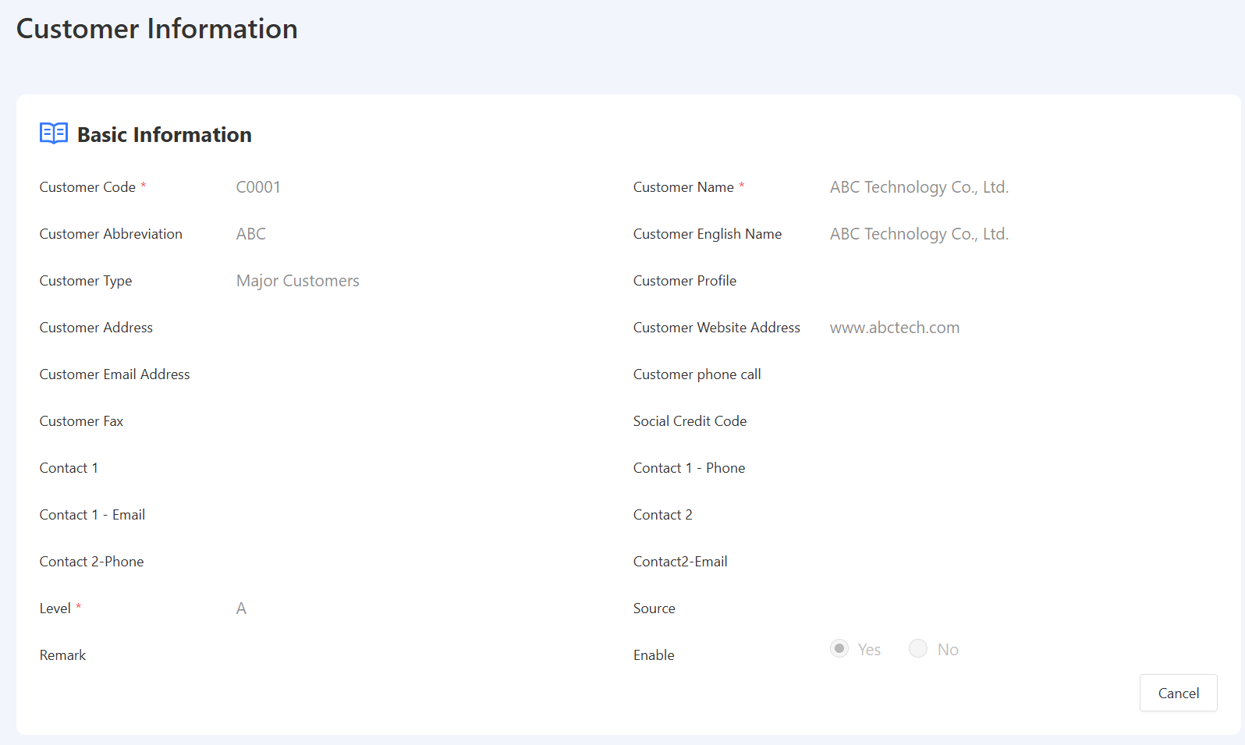
WMS Basic initialization-Customer Information
Description: Add/Edit/Delete customer information
Path: [Basic Settings] -> [Customer Information]
Description: This section is used for maintaining enterprise customer information.
* is required for subsequent creation of sales orders, sales deliveries, and sales returns involving customer information.

Slide 17
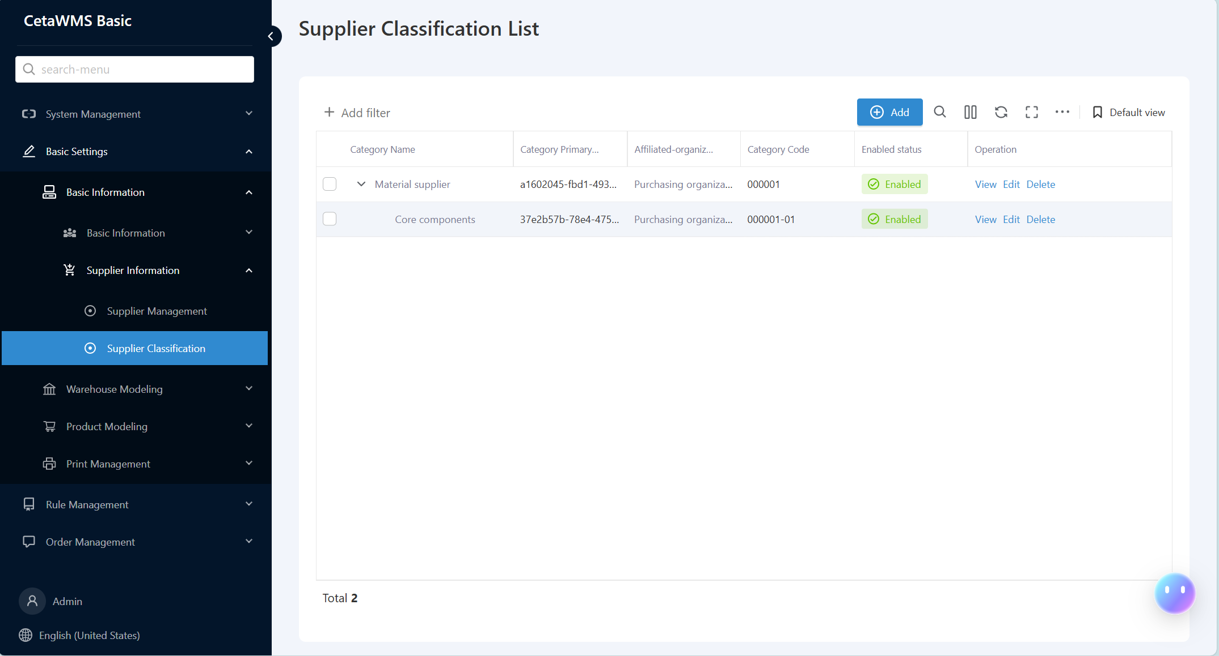
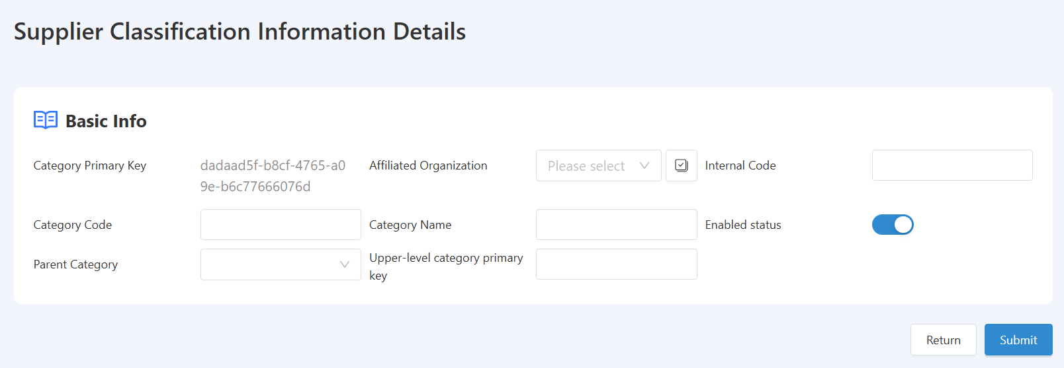
WMS Basic initialization-Supplier Classification
Description: Add/Edit/Delete supplier classification data
Path: [Basic Settings] -> [Supplier Classification]
Description: This section is used for maintaining the classification of enterprise suppliers.
Enterprises can maintain supplier classification information in accordance with internal management requirements, and subsequently establish user supplier profiles.

Slide 18

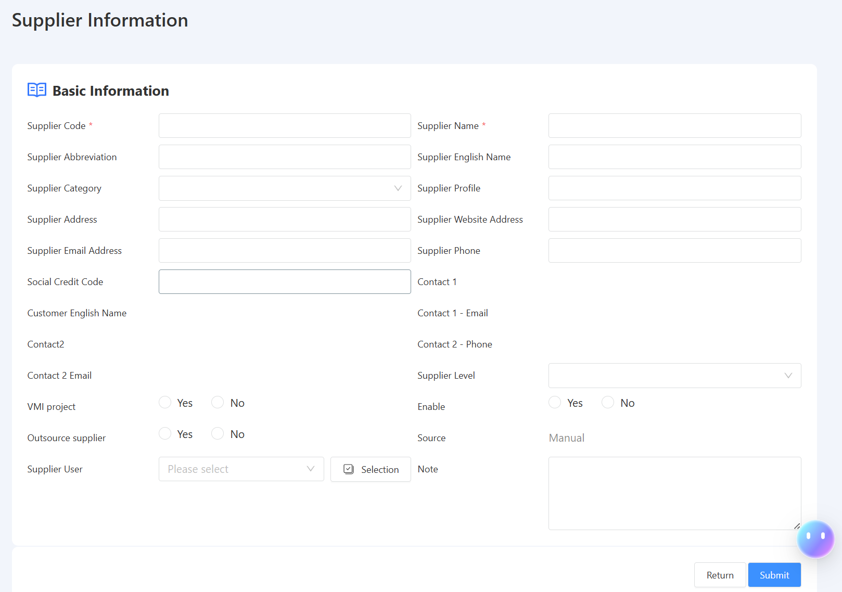
WMS Basic initialization-Supplier Information
Description: Add/Edit/Delete supplier information
Path: [Basic Settings] -> [Supplier Classification]
Description: This section is used for maintaining enterprise supplier information.
* is required for subsequent creation of purchase orders, purchase receipts, and purchase return supplier information transactions.

Slide 19
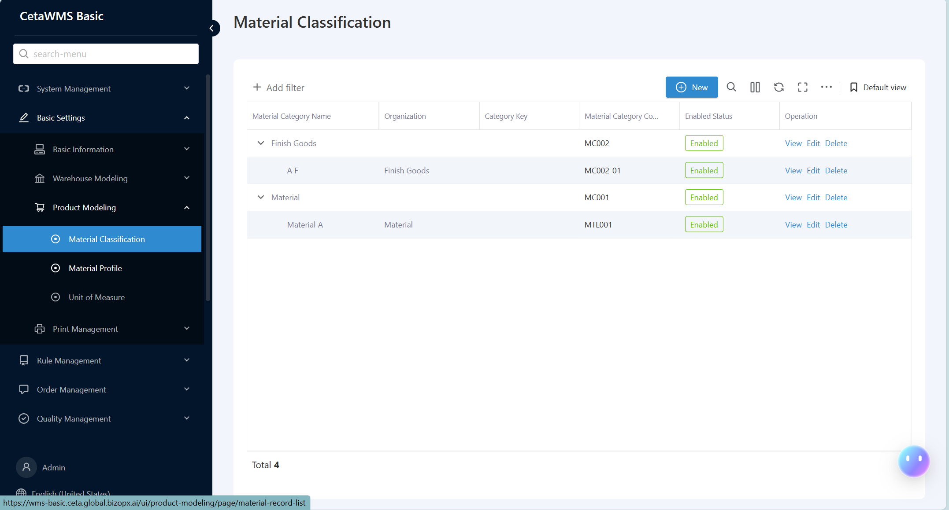
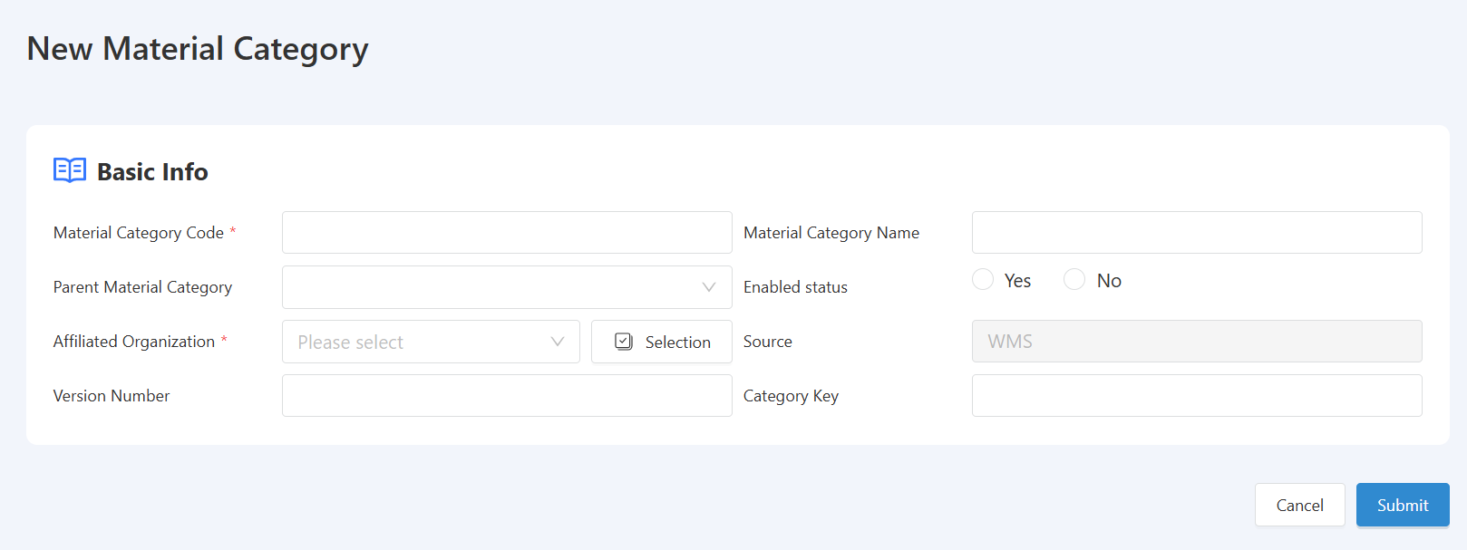
WMS Basic initialization-Material Classification
Description: Add/Edit/Delete Material Classification
Path: [Basic Settings] -> [Material Classification]
Description: This section is used to maintain information on enterprise material classifications, such as raw materials, semi-finished products, finished products, etc.
*This is a required field, used for selecting material classification when creating material master data later.

Slide 20
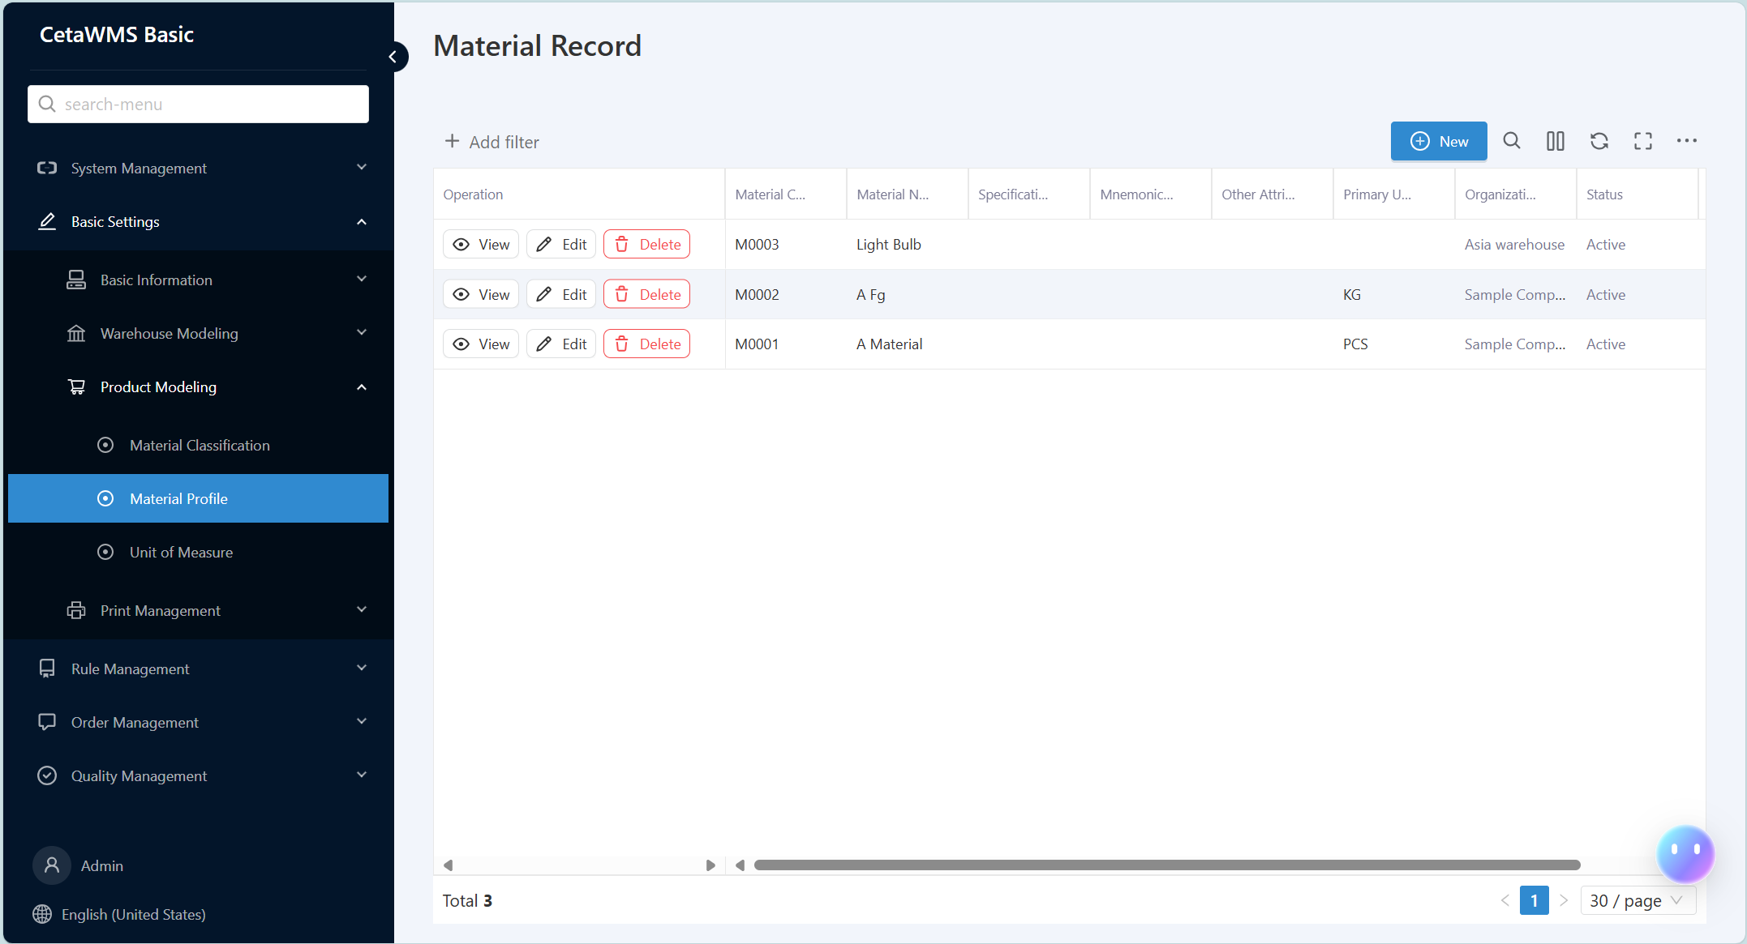
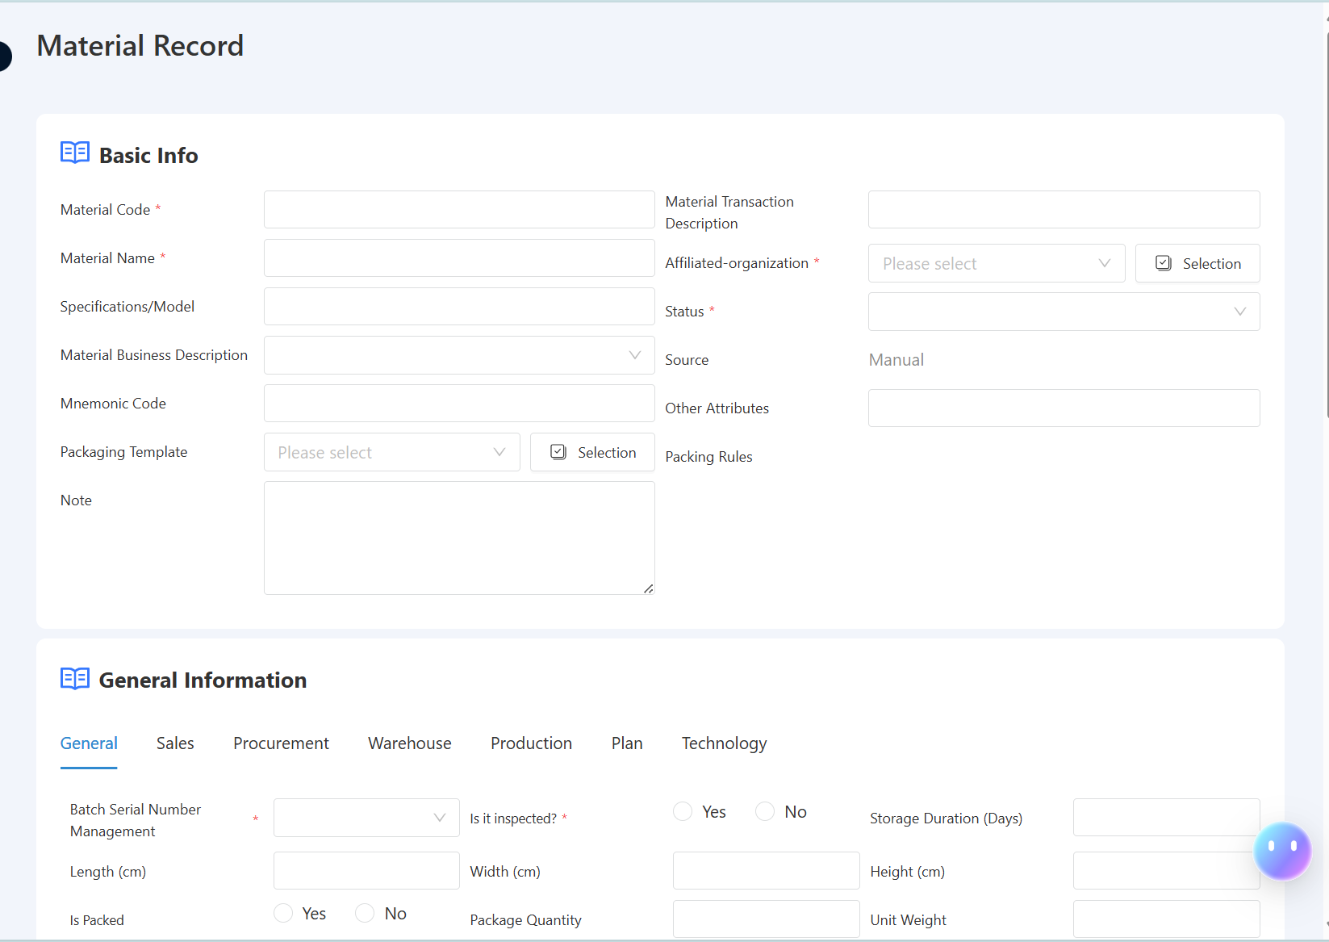
WMS Basic initialization-Material Profile
Description: Add/Edit/Delete Material Master Data
Path: [Basic Settings] -> [Material Profile]
Description: This section is used to maintain basic information about enterprise materials.
* is required for subsequent system operation information entry. For "Whether to Inspect", if the enterprise material is an inspection material, you need to select "Yes". When the purchase is received and stocked, the system will automatically create an inspection instruction for quality operations.

Slide 21
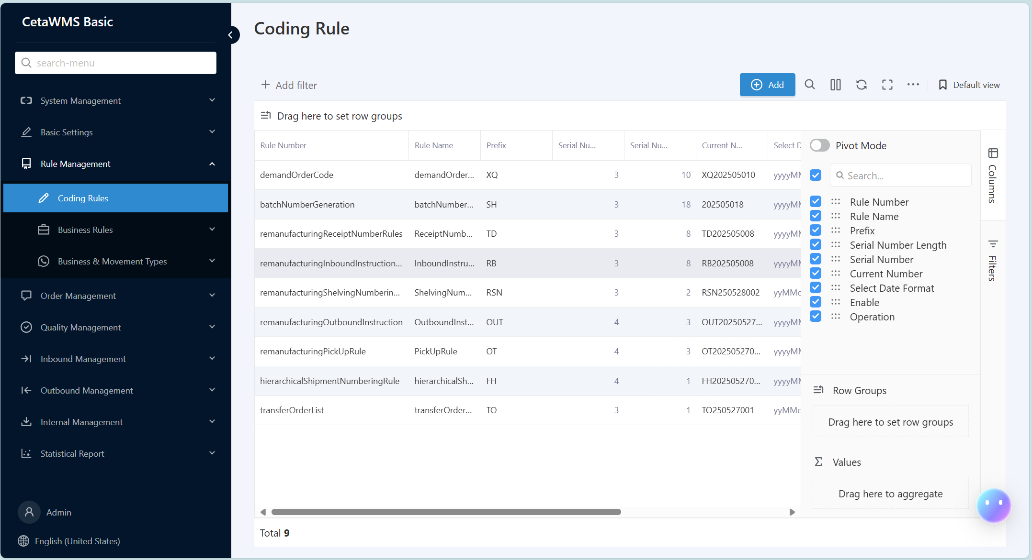
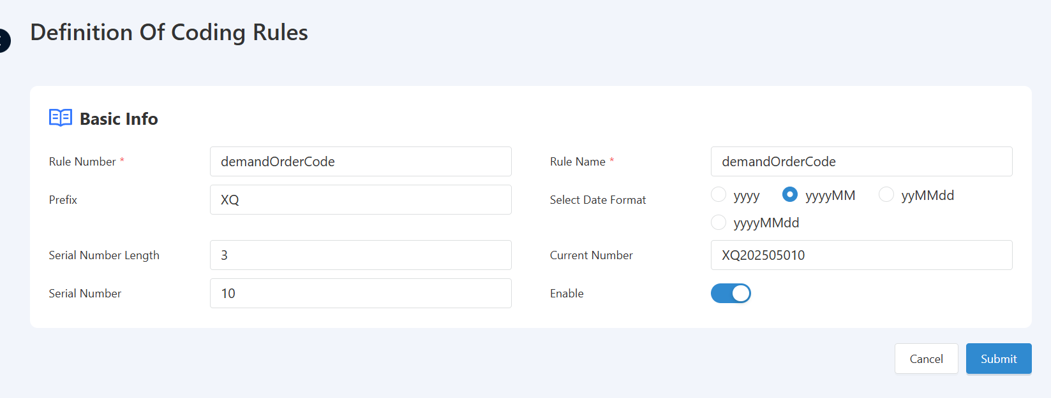
WMS Basic initialization-Coding Rules
Description: Add/Edit/Delete Coding Rules
Path: [Rule Management] -> [Coding Rules]
Description: This section is used for system document/batch and other related coding rules.
* is required for the formation of unique information for subsequent system operations.

Slide 22
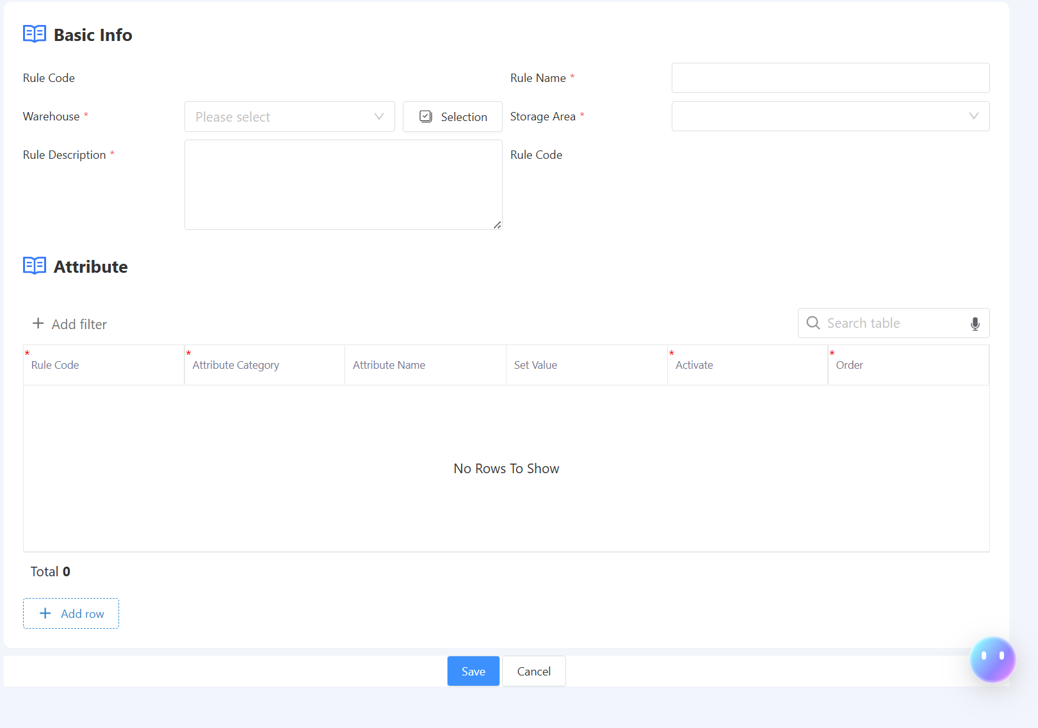
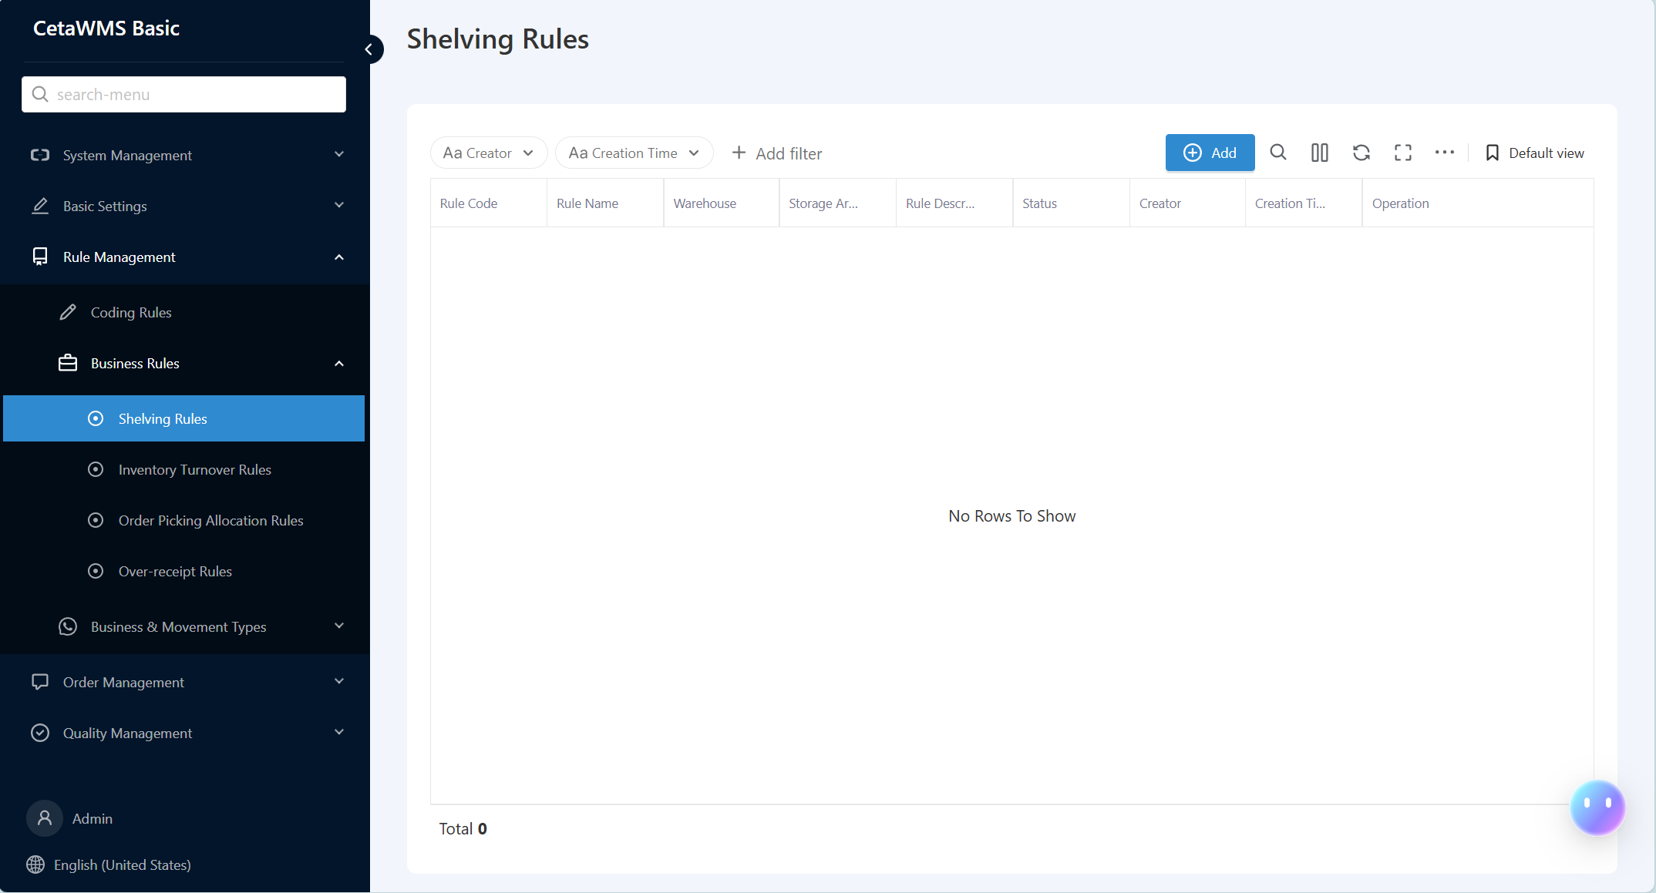
WMS Basic initialization-Shelving Rules
Description: Add/Edit/Delete listing rules
Path: [Rule Management] -> [Shelving Rules]
Description: This section is used for warehouse location management, where the enterprise recommends shelving locations according to certain rules, and the warehouse operators shelve materials according to the recommended locations.
* is required. Currently, the system recommends storage locations based on the principle of "default storage location priority -> previous storage location -> nearest storage location".

Slide 23
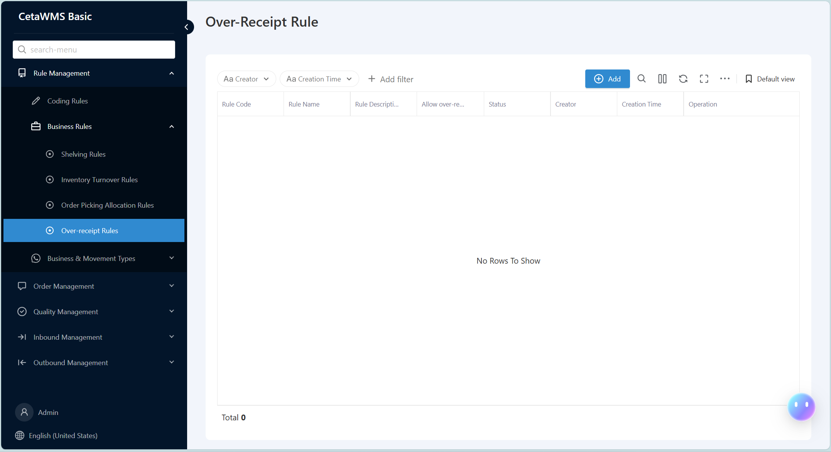
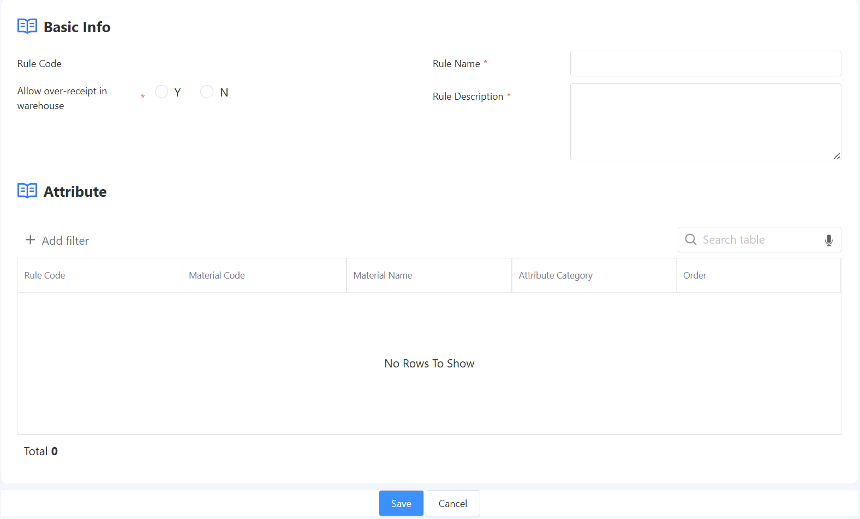
WMS Basic initialization-Over-Receipt Rule
Description: Add/Edit/Delete Overcharge Rules
Path: [Rule Management] -> [Business Rule] -> [Over-Receipt Rule]
Description: This section is used for purchase and inventory management. For the phenomenon of over-receiving corresponding materials in the actual purchase and inventory management of enterprises, the system can set corresponding over-receiving rule proportions for control and management.

Slide 24
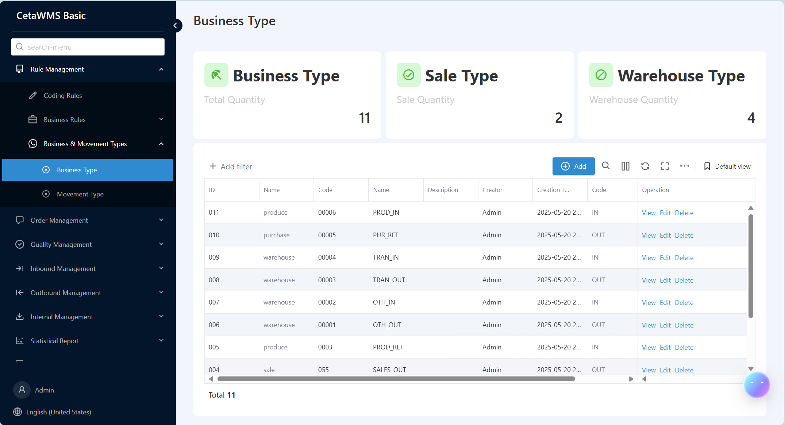
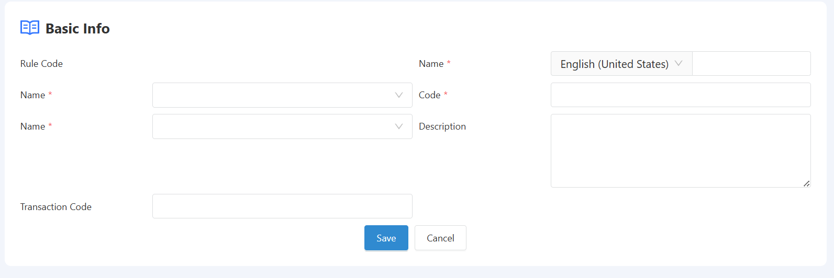
WMS Basic initialization-Business Type
Description: Add/Edit/Delete Business Type
Path: [Rule Management] -> [Business Type]
Description: This section is used to distinguish different types of transactions in actual warehouse operations of enterprises, such as purchase receipts and production picking, to differentiate between different types of inbound and outbound transactions.
* is required. Currently, the system has built-in common inbound and outbound business types used by enterprises, which cannot be deleted.

Slide 25





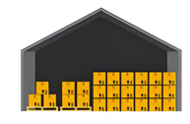
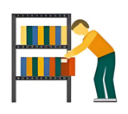




WMS Basic Workflow process overview
Purchase order
Production Order
sale order
Supplier delivery
take delivery of goods
Submission
Storage instruction
PUTAWAY
Outbound order
Pick up and remove from shelves
send out goods
allocate and transfer
test
Recommended for listing
Outbound instruction
stocktaking
Freeze/Unfreeze
lock/unlock
Packing/palletizing

Slide 26


WMS Basic - Purchase Order
Description: Add/Edit/Delete Purchase Orders
Path: [Order Management] -> [Purchase Order]
Description: This section is used for enterprise purchase order business, where the purchaser enters detailed purchase information based on purchasing needs.
* is required. The purchase order serves as the source of purchase receipt, and the system will automatically create the information for pending receipt upon the creation of the purchase order.

Slide 27



WMS Basic - Inbound Order
Description: View pending orders for inventory entry
Path: [Inbound Management] -> [Inbound Order]
Description: This section is used for enterprise purchase order business, where the purchaser enters detailed purchase information based on purchasing needs.
* is required. The purchase order is the source of the purchase receipt. The system will automatically create the pending receipt information when the purchase order is created.

Slide 28



WMS Basic - Receipt Document
Description: Add/Edit/Delete Receipts
Path: [Inbound Management] -> [Receipt Document]
Description: This section is used for the warehouse to obtain purchase orders pending stock-in based on supplier deliveries. The system automatically retrieves the pending stock-in information and populates the data based on the actual received quantity.
* is required. Based on the current pending order, multiple deliveries can be initiated until the order is marked as "Cleared", or the purchase order can be manually closed.

Slide 29


WMS Basic - Inspection Items
Description: Add/Edit/Delete Inspection Items
Path: [Quality Management] -> [Basic Information] -> [Inspection Items]
Description: This section is used for quality management business. It is the basic data management section, requiring quality management personnel to maintain inspection items related to the enterprise, which are used for subsequent inspection scheme options.
* is required. The inspection item is used for enterprises to conduct detailed quality management information registration.

Slide 30


WMS Basic - Inspection Plan
Description: Add/Edit/Delete Inspection Plan
Path: [Quality Management] -> [Basic Information] -> [Inspection Plan]
Description: This section is used for quality management business. It is a basic data management section that requires quality management personnel to maintain enterprise-related quality defects. It is used to maintain the reasons for poor quality found during inspection processes.
This section is optional. If any poor quality is found, the system will not allow it to be entered into the inventory.

Slide 31


WMS Basic initialization-
Description: Add/Edit/Delete Inspection Items
Path: [Quality Management] -> [Basic Information] -> [Cause For Defect]
Description: This section is used for quality management business. It is the basic data management section, requiring quality management personnel to maintain the enterprise's relevant quality inspection schemes.
The inspection scheme is maintained here, and the material [inspection] is set to [yes]. Based on this data, the system initiates the receipt and automatically creates an inspection instruction.

Slide 32


WMS Basic - Inspection Instruction
Description: Query/Edit Inspection Instructions
Path: [Quality Management] -> [Incoming Material Quality] -> [Inspection Instruction]
Description: This section is used for quality management operations. Based on system settings and inspection schemes, inspection instructions are automatically initiated by the receipt of goods, serving as the basis for the current inspection operations.
The inspection scheme is maintained here, and the material is set to 'Inspect' as 'Yes'. Based on this data, the system initiates the receipt and automatically creates an inspection order.

Slide 33



WMS Basic - Inspection Operation
Description: Query/Edit Inspection Job
Path: [Quality Management] -> [Incoming Material Quality] -> [Inspection Operation]
Description: This section is used for quality management business. Based on the inspection instructions, the inspector clicks to create an inspection task, which will be automatically generated.
Inspectors maintain detailed inspection content and results based on inspection tasks.

Slide 34


WMS Basic - Inbound Instruction
Description: Add/Edit/Delete Inventory Entry
Path: [Inbound Management] -> [Inbound Instruction]
Description: This section is used for warehouse inventory management. Based on the goods receipt note or the goods receipt note that has passed inspection, the warehouse needs to confirm the quantity of goods received and complete the final warehouse accounting.
Note: If the selected warehouse in this section is managed by storage location, the system will recommend storage location information and generate a task pending for shelving. If there is no storage location management, the warehouse entry will be automatically completed.

Slide 35


WMS Basic - Shelving Management
Description: Edit and list
Path: [Inbound Management] -> [Shelving Management]
Description: This section is used for warehouse inventory operations. Based on the recommended pending shelving operations for inventory operations, it is completed according to the actual storage location of the materials in the warehouse.
Note: Based on the recommended warehouse location, the item can be directly shelved. If a change in location is required, an alternative location can be selected and filled in.

Slide 36


WMS - Production Order
Description: Add/Edit/Delete Production Orders
Path: [Order Management] -> [Production Order]
Description: This section is used for production order business. If the enterprise has production business, it can maintain the enterprise's production orders for later use in the enterprise's production business, where materials are collected and used for production.
Note: The system currently supports enterprises in maintaining production orders and their components, issuing materials for production based on the current components, and completing production receipts based on the products.

Slide 37


WMS Basic - Sale Order
Description: Add/Edit/Delete Sales Orders
Path: [Order Management] -> [Sale Order]
Description: This section is used for sales business, where sales orders are maintained as the basis for sales delivery.
Note: Only sales orders that have undergone system maintenance can serve as the basis for sales delivery and create pending delivery tasks.

Slide 38



WMS Basic - Outbound Order
Description: Add/Edit/Delete Outbound Orders
Path: [Outbound Management] -> [Outbound Order]
Description: The outbound orders created by the system represent the pending outbound requests. Warehouse personnel are required to select the orders that need to be issued based on different business types, and then click on [Instruction] to generate an [Outbound Instruction].

Slide 39


WMS Basic - Outbound Instruction
Description: Add/Edit/Delete Outbound Instructions - Edit Picking
Path: [Outbound Management] -> [Outbound Instruction]
Description: The system generates an outbound instruction, and the warehouse can proceed with picking and shipping based on the current instruction. Clicking [Picking] will generate [Shipping].
Note: The system makes recommendations based on the picking and shipping system, which operates on the principle of first-in, first-out (FIFO) for shipping batches, as well as warehouse location data.

Slide 40


WMS Basic - Order Picking and De-shelving
Description: Editing and removing items from the shelves during goods picking
Path: [Outbound Management] -> [Order Picking and De-shelving]
Description: The system generates an outbound instruction, and the warehouse can perform picking and shipping based on the current instruction. Clicking on [Picking] allows the warehouse keeper to select relevant batches and storage location information based on the current outbound instruction data.

Slide 41


WMS Basic - Shipping
Description: Edit and remove items from the shelves during goods picking
Path: [Outbound Management] -> [Shipping]
Description: The system generates an outbound instruction, based on which the warehouse can proceed with picking and shipping. Clicking on [Picking] allows the warehouse manager to select or scan relevant batch and storage location information based on the current outbound instruction data.
Note: After submission here, the system will generate inventory transactions and deduct corresponding inventory data

Slide 42


WMS Basic - Lock
Description: Add warehouse/storage area/storage location locking
Path: [Internal Management] -> [Lock]
Description: Based on daily warehouse management operations such as inventory checking and access prohibition, it is necessary to lock the warehouse through the system, allowing operations within this business context.

Slide 43


WMS Basic - Release
Description: Add unlocking for warehouse/storage area/storage location
Path: [Internal Management] -> [Release]
Description: Based on the daily business of warehouse management, the warehouse business needs to be unlocked, and operations can be performed in this business.

Slide 44


WMS Basic - Warehouse Transfer Management
Description: Add warehouse transfer
Path: [Internal Management] -> [Warehouse Transfer Management]
Description: The daily internal management of the warehouse is used to address the relocation of items between storage locations.

Slide 45


WMS Basic - Transfer Order
Description: Inventory transfer
Path: [Internal Management] -> [Transfer Order]
Description: Daily internal warehouse management is used to facilitate inventory transfers between warehouses, enabling the transfer of inventory quantities.

Slide 46



WMS Basic - Inventory Data
Description: Query inventory data
Path: [Inventory Data]
Description: The daily management of the warehouse involves querying current inventory data, which includes [batch inventory data] and [storage location inventory data].

Slide 47


WMS Basic - AI Agents
Description: AI Agents
Path: [AI Agents]
Description: You can establish an AI assistant to help you handle business, query data, and guide system usage.

Slide 48
thank you!

